Slide 1
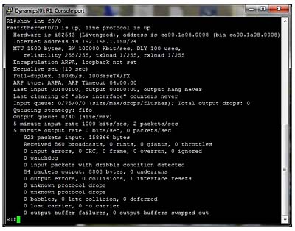
The black art of networking
sh ….I T

Slide 2
Cisco ASA Unique Visibility User inside and Out
Gigaflow that can see Remote IP –User and inside IP - User
10.106.5.40
( payroll.net.)
10.254.123.161
User:Warr123
(Internal assigned IP)
165.26.8.16 User: Warr123
(Remote User External IP)
Notes:
Customers are struggling in keeping communication flowing – so that they can still function as a company.
Lack of “owned” infrastructure. BYOD causing security/risk issues – however important to note customer should not care about this at this point – the important thing is to keep the data moving.
Out-sourced Infrastructure - visibility may be lacking in this instance
Identify and remove choke points - identify misuse of traffic
What’s happening now needs to be accounted for so that it can be rationalised later. Archive now for forensic analysis later

Slide 3
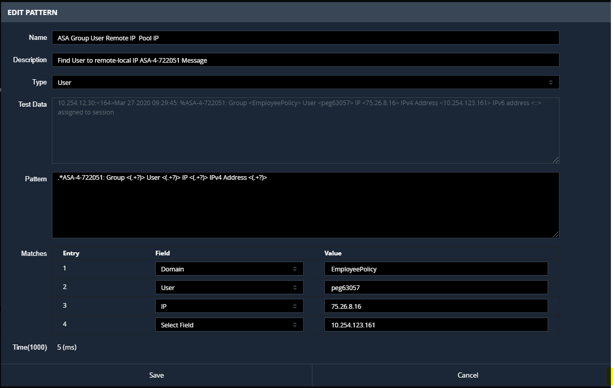
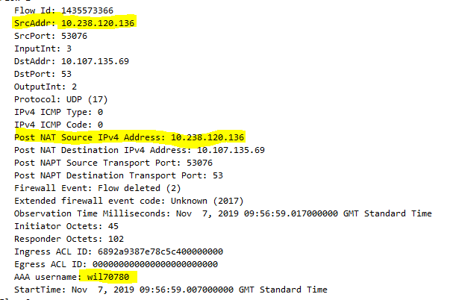
10.254.123.161
(Pool assigned address)
User:WARR123
User:Warr123
65.26.8.16
(Remote User External IP)
89.238.250.100
10.254.12.30
NSEL (Flow)
10.106.5.40
( winsbox01.XX.net.)
Session Syslog
Bi Directional NSEL Flow records
Initiator IP | Responder IP | Initiator Bytes | Responder Bytes | Initiator Pkts | Responder Pkts | …NAT !…
Initiator IP | Responder IP | Initiator Bytes | Responder Bytes | Initiator Pkts | Responder Pkts | USER

Slide 4
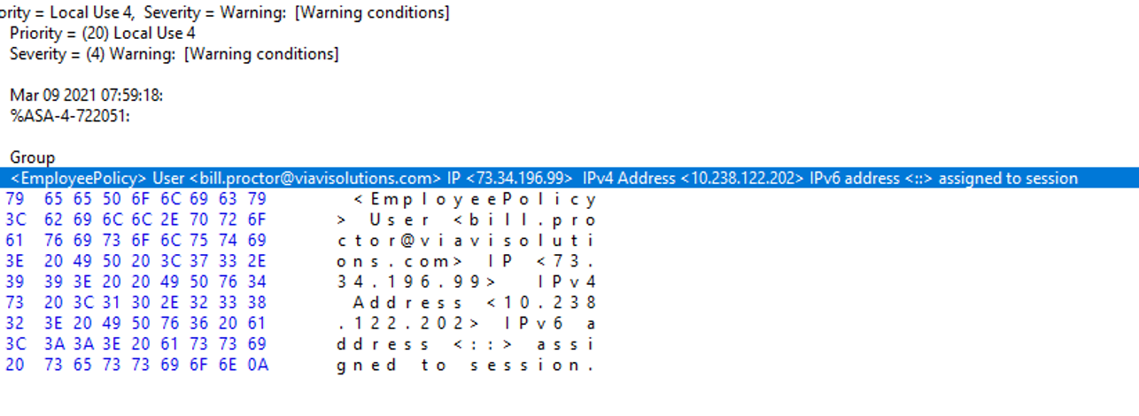

Slide 5
