Slide 1
Key Points
You can create flow logs for network interfaces that are
created by other AWS services,
“requester-managed”
Elastic Load Balancing
Amazon RDS
Amazon ElastiCache
Amazon Redshift
NAT gateways
Transit gateways
VPCflow generated and exported from Interface and sent as source interface NOT device sender!
Vflow can be configured to be produced by VPC, a subnet, or a network interface
Default Version 2 in set order
Version 3-5 fields used by defining Custom “record”
Aggregate check time (cache ) make 1 min
AWS requester-managed “devices” do not have instance id
Can apply tags to your flow logs
Publishing flow log data to Amazon S3 STRING or format is Parquet
Pkt-srcaddr The packet-level (original) source IP address of the traffic. Version 3 field !
Use this field with the srcaddr field to distinguish between the IP address of an intermediate layer through which traffic flows, and the original source IP address of the traffic. For example, when traffic flows
through a network interface for a NAT gateway, or where the IP address of a pod in Amazon EKS is different from the IP address of the network interface of the instance node on which the pod is running (for communication within a VPC).
Subnet store as meta but build sites from subnets discovery would be better
The path that egress traffic takes to the destination.
To determine whether the traffic is egress traffic, check the flow-direction field.
The possible values are as follows.
If none of the values apply, the field is set to -.
1 — Through another resource in the same VPC
2 — Through an internet gateway or a gateway VPC endpoint
3 — Through a virtual private gateway
4 — Through an intra-region VPC peering connection
5 — Through an inter-region VPC peering connection
6 — Through a local gateway
7 — Through a gateway VPC endpoint (Nitro-based instances only)
8 — Through an internet gateway (Nitro-based instances only)
Question
Is eni id unique and how unique ???
S3 need to delete old data

Slide 2
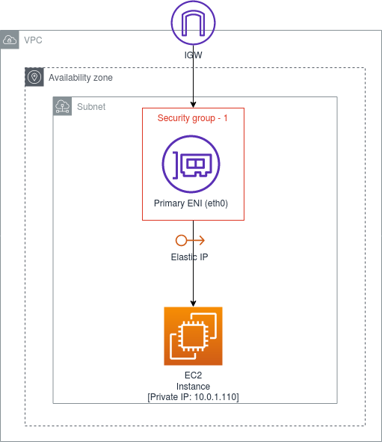
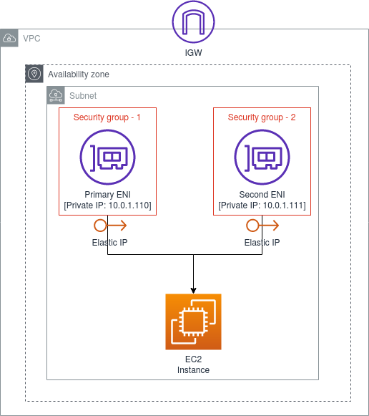
Elastic Network Interface (ENI)
ENI is a logical networking component in a VPC that represents a Virtual Network Card. It can have the following attributes.
A primary private IPv4 address
One or more secondary private IPv4 addresses
One Elastic IP Address (IPv4) per private IPV4 address
One public IPv4 address
One or more IPv6 addresses
One or more security groups
A MAC address
A source/destination check flag
ENI — Key Features
Each instance in your VPC has a default network interface (the primary network interface — eth0) that assigns a private IPv4 address from the IPv4 address range of your VPC (See Figure 1).
You cannot detach the default (primary) network interface from an instance.
You can create an attach an additional/ secondary ENIs to an instance in your VPC. However, these ENIs should be created within the same availability zone of the EC2 instance that you are trying to attach your secondary ENI (See Figure 2). The number of network instances you can attach varies by instance type.
A Security Group is attached to an ENI not an EC2 instance. With this approach you can have multiple routes to the same EC2 instance with different security configurations.
You can create a network interface, attach it to an instance, detach it from an instance and attach it to another instance within the same Availability Zone. A network interface’s attributes follow it as it is attached or detached from an instance and reattached to another instance. When you move a network interface from one instance to another, network traffic is redirected to the new instance.

Slide 3
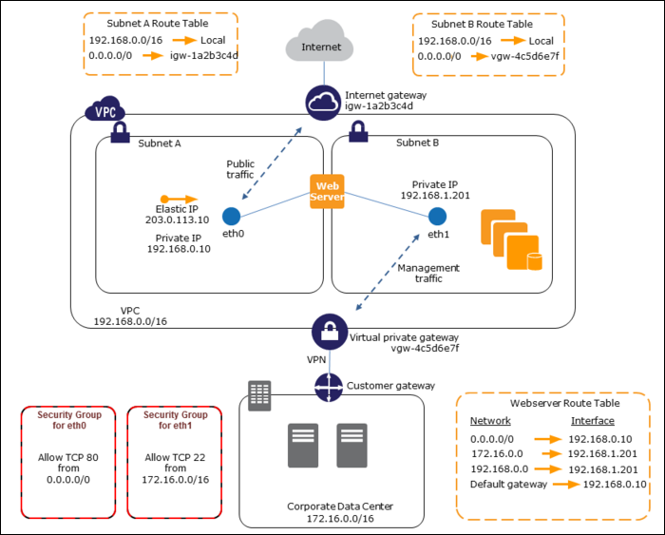
You’re not limited to just one network interface though—attaching a secondary network interface allows you to connect your EC2 instance to two networks at once, which can be very useful when designing your network architecture. You can use them to host load balancers, proxy servers, and NAT servers on an EC2 instance, routing traffic from one subnet to another.
ENIs have security groups, just like EC2 instances, which act as a built in firewall. You can use these, rather than a Linux firewall like iptables, to manage inter-subnet traffic.
A common use case for ENIs is the creation of management networks. This allows you to have public-facing applications like web servers in a public subnet but lock down SSH access down to a private subnet on a secondary network interface. In this scenario, you would connect using a VPN to the private management subnet, then administrate your servers as usual.
In this diagram, the subnet on the left is the public subnet, which communicates with the internet over the Internet Gateway for the VPC. The subnet on the right is the private management subnet, which can only be accessed in this example by the AWS Direct Connect gateway, which allows the on-premises network to handle authentication, and simply extends that network into the cloud. You could also use AWS Client VPN, which will run a VPN server that can be accessed with private key credentials.

Slide 4
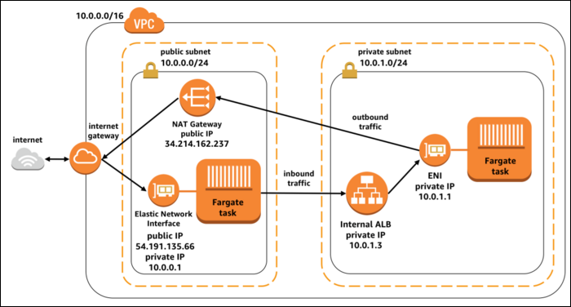
ENIs are also often used as the primary network interfaces for Docker containers launched on ECS using Fargate. This allows Fargate tasks to handle complex networking, set firewalls in place using security groups, and be launched into private subnets.

Slide 5
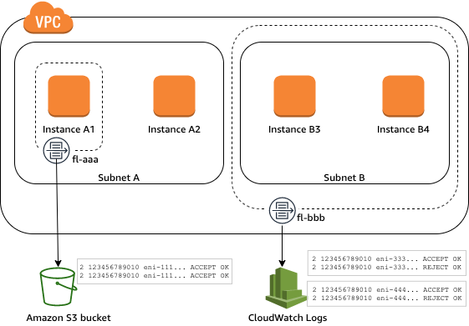
Flow logs basics
You can create a flow log for a VPC, a subnet, or a network interface. If you create a flow log for a subnet or VPC, each network interface in that subnet or VPC is monitored.
Flow log data for a monitored network interface is recorded as flow log records, which are log events consisting of fields that describe the traffic flow. For more information, see Flow log records.
To create a flow log, you specify:
The resource for which to create the flow log
The type of traffic to capture (accepted traffic, rejected traffic, or all traffic)
The destinations to which you want to publish the flow log data
In the following example, you create a flow log (fl-aaa) that captures accepted traffic for the network interface for instance A1 and publishes the flow log records to an Amazon S3 bucket.
You create a second flow log that captures all traffic for subnet B and publishes the flow log records to Amazon CloudWatch Logs.
The flow log (fl-bbb) captures traffic for all network interfaces in subnet B. There are no flow logs that capture traffic for instance A2's network interface.
After you create a flow log, it can take several minutes to begin collecting and publishing data to the chosen destinations. Flow logs do not capture real-time log streams for your network interfaces .
If you launch an instance into your subnet after you create a flow log for your subnet or VPC, we create a log stream (for CloudWatch Logs) or log file object (for Amazon S3)
for the new network interface as soon as there is network traffic for the network interface.
You can create flow logs for network interfaces that are created by other AWS services, such as:
Elastic Load Balancing
Amazon RDS
Amazon ElastiCache
Amazon Redshift
NAT gateways
Transit gateways
Regardless of the type of network interface, you must use the Amazon EC2 console or the Amazon EC2 API to create a flow log for a network interface.
You can apply tags to your flow logs. Each tag consists of a key and an optional value, both of which you define. Tags can help you organize your flow logs, for example by purpose or owner.
If you no longer require a flow log, you can delete it. Deleting a flow log disables the flow log service for the resource, and no new flow log records are created or published to CloudWatch Logs or Amazon S3.
Deleting the flow log does not delete any existing flow log records or log streams (for CloudWatch Logs) or log file objects (for Amazon S3) for a network interface.
To delete an existing log stream, use the CloudWatch Logs console. To delete existing log file objects, use the Amazon S3 console.
After you've deleted a flow log, it can take several minutes to stop collecting data. For more information

Slide 6
Flow log records
A flow log record represents a network flow in your VPC. By default, each record captures a network internet protocol (IP) traffic flow (characterized by a 5-tuple on a per network interface basis) that occurs within an aggregation interval, also referred to as a capture window.
Each record is a string with fields separated by spaces. A record includes values for the different components of the IP flow, for example, the source, destination, and protocol.
When you create a flow log, you can use the default format for the flow log record, or you can specify a custom format.
Contents
Aggregation interval
Default format
Custom format
Available fields
Aggregation interval
The aggregation interval is the period of time during which a particular flow is captured and aggregated into a flow log record. By default, the maximum aggregation interval is 10 minutes. When you create a flow log, you can optionally specify a maximum aggregation interval of 1 minute. Flow logs with a maximum aggregation interval of 1 minute produce a higher volume of flow log records than flow logs with a maximum aggregation interval of 10 minutes.
When a network interface is attached to a Nitro-based instance, the aggregation interval is always 1 minute or less, regardless of the specified maximum aggregation interval.
After data is captured within an aggregation interval, it takes additional time to process and publish the data to CloudWatch Logs or Amazon S3. The flow log service typically delivers logs to CloudWatch Logs in about 5 minutes and to Amazon S3 in about 10 minutes. However, log delivery is on a best effort basis, and your logs might be delayed beyond the typical delivery time.
Default format
With the default format, the flow log records include the version 2 fields, in the order shown in the available fields table. You cannot customize or change the default format. To capture additional fields or a different subset of fields, specify a custom format instead.
Custom format
With a custom format, you specify which fields are included in the flow log records and in which order. This enables you to create flow logs that are specific to your needs and to omit fields that are not relevant. Using a custom format can reduce the need for separate processes to extract specific information from the published flow logs. You can specify any number of the available flow log fields, but you must specify at least one.
Available fields
The following table describes all of the available fields for a flow log record. The Version column indicates the VPC Flow Logs version in which the field was introduced.
The default format includes all version 2 fields, in the same order that they appear in the table.
When publishing flow log data to Amazon S3, the data type for the fields depends on the flow log format. If the format is plain text, all fields are of type STRING. If the format is Parquet, see the table for the field data types.
If a field is not applicable or could not be computed for a specific record, the record displays a '-' symbol for that entry. Metadata fields that do not come directly from the packet header are best effort approximations, and their values might be missing or inaccurate.

Slide 7
Field | GF Field | Description | Version
version |  | The VPC Flow Logs version. If you use the default format, the version is 2. If you use a custom format, the version is the highest version among the specified fields. For example, if you specify only fields from version 2, the version is 2. If you specify a mixture of fields from versions 2, 3, and 4, the version is 4. Parquet data type: INT_32 | 2
account-id |  | The AWS account ID of the owner of the source network interface for which traffic is recorded. If the network interface is created by an AWS service, for example when creating a VPC endpoint or Network Load Balancer, the record might display unknown for this field. Parquet data type: STRING | 2
interface-id |  | The ID of the network interface for which the traffic is recorded. Parquet data type: STRING | 2
srcaddr | srcip | The source address for incoming traffic, or the IPv4 or IPv6 address of the network interface for outgoing traffic on the network interface. The IPv4 address of the network interface is always its private IPv4 address. See also pkt-srcaddr. Parquet data type: STRING | 2
dstaddr | dstip | The destination address for outgoing traffic, or the IPv4 or IPv6 address of the network interface for incoming traffic on the network interface. The IPv4 address of the network interface is always its private IPv4 address. See also pkt-dstaddr. Parquet data type: STRING | 2
srcport | srcport | The source port of the traffic. Parquet data type: INT_32 | 2
dstport | dstport | The destination port of the traffic. Parquet data type: INT_32 | 2
protocol | protocol | The IANA protocol number of the traffic. For more information, see Assigned Internet Protocol Numbers. Parquet data type: INT_32 | 2
packets | packets | The number of packets transferred during the flow. Parquet data type: INT_64 | 2
bytes | bytes | The number of bytes transferred during the flow. Parquet data type: INT_64 | 2
start | start | The time, in Unix seconds, when the first packet of the flow was received within the aggregation interval. This might be up to 60 seconds after the packet was transmitted or received on the network interface. Parquet data type: INT_64 | 2
end | duration | The time, in Unix seconds, when the last packet of the flow was received within the aggregation interval. This might be up to 60 seconds after the packet was transmitted or received on the network interface. Parquet data type: INT_64 | 2
action | FW Event | The action that is associated with the traffic: ACCEPT — The recorded traffic was permitted by the security groups and network ACLs. REJECT — The recorded traffic was not permitted by the security groups or network ACLs. Parquet data type: STRING | 2
log-status |  | The logging status of the flow log: OK — Data is logging normally to the chosen destinations. NODATA — There was no network traffic to or from the network interface during the aggregation interval. SKIPDATA — Some flow log records were skipped during the aggregation interval. This might be because of an internal capacity constraint, or an internal error. Parquet data type: STRING | 2
vpc-id | The ID of the VPC that contains the network interface for which the traffic is recorded. Parquet data type: STRING | 3
subnet-id | The ID of the subnet that contains the network interface for which the traffic is recorded. Parquet data type: STRING | 3
instance-id | The ID of the instance that's associated with network interface for which the traffic is recorded, if the instance is owned by you. Returns a '-' symbol for a requester-managed network interface; for example, the network interface for a NAT gateway. Parquet data type: STRING | 3
tcp-flags | The bitmask value for the following TCP flags: SYN — 2 SYN-ACK — 18 FIN — 1 RST — 4 ACK is reported only when it's accompanied with SYN. TCP flags can be OR-ed during the aggregation interval. For short connections, the flags might be set on the same line in the flow log record, for example, 19 for SYN-ACK and FIN, and 3 for SYN and FIN. For an example, see TCP flag sequence. Parquet data type: INT_32 | 3
type | The type of traffic. The possible values are: IPv4 | IPv6 | EFA. For more information, see Elastic Fabric Adapter. Parquet data type: STRING | 3
pkt-srcaddr | The packet-level (original) source IP address of the traffic. Use this field with the srcaddr field to distinguish between the IP address of an intermediate layer through which traffic flows, and the original source IP address of the traffic. For example, when traffic flows through a network interface for a NAT gateway, or where the IP address of a pod in Amazon EKS is different from the IP address of the network interface of the instance node on which the pod is running (for communication within a VPC). Parquet data type: STRING | 3
pkt-dstaddr | The packet-level (original) destination IP address for the traffic. Use this field with the dstaddr field to distinguish between the IP address of an intermediate layer through which traffic flows, and the final destination IP address of the traffic. For example, when traffic flows through a network interface for a NAT gateway, or where the IP address of a pod in Amazon EKS is different from the IP address of the network interface of the instance node on which the pod is running (for communication within a VPC). Parquet data type: STRING | 3
region | The Region that contains the network interface for which traffic is recorded. Parquet data type: STRING eg eu-west-1 (Dublin) | 4
az-id | The ID of the Availability Zone that contains the network interface for which traffic is recorded. If the traffic is from a sublocation, the record displays a '-' symbol for this field. Parquet data type: STRING | 4
sublocation-type | The type of sublocation that's returned in the sublocation-id field. The possible values are: wavelength | outpost | localzone. If the traffic is not from a sublocation, the record displays a '-' symbol for this field. Parquet data type: STRING | 4
sublocation-id | The ID of the sublocation that contains the network interface for which traffic is recorded. If the traffic is not from a sublocation, the record displays a '-' symbol for this field. Parquet data type: STRING | 4
pkt-src-aws-service | The name of the subset of IP address ranges for the pkt-srcaddr field, if the source IP address is for an AWS service. The possible values are: AMAZON | AMAZON_APPFLOW | AMAZON_CONNECT | API_GATEWAY | CHIME_MEETINGS | CHIME_VOICECONNECTOR | CLOUD9 | CLOUDFRONT | CODEBUILD | DYNAMODB | EBS | EC2 | EC2_INSTANCE_CONNECT | GLOBALACCELERATOR | KINESIS_VIDEO_STREAMS | ROUTE53 | ROUTE53_HEALTHCHECKS | ROUTE53_HEALTHCHECKS_PUBLISHING | ROUTE53_RESOLVER | S3 | WORKSPACES_GATEWAYS. Parquet data type: STRING | 5
pkt-dst-aws-service | The name of the subset of IP address ranges for the pkt-dstaddr field, if the destination IP address is for an AWS service. For a list of possible values, see the pkt-src-aws-service field. Parquet data type: STRING | 5
flow-direction | The direction of the flow with respect to the interface where traffic is captured. The possible values are: ingress | egress. Parquet data type: STRING | 5
traffic-path | The path that egress traffic takes to the destination. To determine whether the traffic is egress traffic, check the flow-direction field. The possible values are as follows. If none of the values apply, the field is set to -. 1 — Through another resource in the same VPC 2 — Through an internet gateway or a gateway VPC endpoint 3 — Through a virtual private gateway 4 — Through an intra-region VPC peering connection vpcs in dub-ldub 5 — Through an inter-region VPC peering connection vpc dub lon 6 — Through a local gateway 7 — Through a gateway VPC endpoint (Nitro-based instances only) 8 — Through an internet gateway (Nitro-based instances only) Parquet data type: INT_32 | 5

Slide 8
Field | GF Field | Extended | Description | Version
version |  |  | The VPC Flow Logs version. If you use the default format, the version is 2. If you use a custom format, the version is the highest version among the specified fields. For example, if you specify only fields from version 2, the version is 2. If you specify a mixture of fields from versions 2, 3, and 4, the version is 4. Parquet data type: INT_32 | 2
account-id |  | meta | The AWS account ID of the owner of the source network interface for which traffic is recorded. If the network interface is created by an AWS service, for example when creating a VPC endpoint or Network Load Balancer, the record might display unknown for this field. Parquet data type: STRING | 2
interface-id |  | IN int if Ingress OUT int if Egress | The ID of the network interface for which the traffic is recorded. Parquet data type: STRING | 2
srcaddr | srcip |  | The source address for incoming traffic, or the IPv4 or IPv6 address of the network interface for outgoing traffic on the network interface. The IPv4 address of the network interface is always its private IPv4 address. See also pkt-srcaddr. Parquet data type: STRING | 2
dstaddr | dstip |  | The destination address for outgoing traffic, or the IPv4 or IPv6 address of the network interface for incoming traffic on the network interface. The IPv4 address of the network interface is always its private IPv4 address. See also pkt-dstaddr. Parquet data type: STRING | 2
srcport | srcport |  | The source port of the traffic. Parquet data type: INT_32 | 2
dstport | dstport |  | The destination port of the traffic. Parquet data type: INT_32 | 2
protocol | protocol |  | The IANA protocol number of the traffic. For more information, see Assigned Internet Protocol Numbers. Parquet data type: INT_32 | 2
packets | packets |  | The number of packets transferred during the flow. Parquet data type: INT_64 | 2
bytes | bytes |  | The number of bytes transferred during the flow. Parquet data type: INT_64 | 2
start | start |  | The time, in Unix seconds, when the first packet of the flow was received within the aggregation interval. This might be up to 60 seconds after the packet was transmitted or received on the network interface. Parquet data type: INT_64 | 2
end | duration |  | The time, in Unix seconds, when the last packet of the flow was received within the aggregation interval. This might be up to 60 seconds after the packet was transmitted or received on the network interface. Parquet data type: INT_64 | 2
action | FW Event |  | The action that is associated with the traffic: ACCEPT — The recorded traffic was permitted by the security groups and network ACLs. REJECT — The recorded traffic was not permitted by the security groups or network ACLs. Parquet data type: STRING | 2
log-status |  |  | The logging status of the flow log: OK — Data is logging normally to the chosen destinations. NODATA — There was no network traffic to or from the network interface during the aggregation interval. SKIPDATA — Some flow log records were skipped during the aggregation interval. This might be because of an internal capacity constraint, or an internal error. Parquet data type: STRING | 2

Slide 9
vpc-id |  | meta | The ID of the VPC that contains the network interface for which the traffic is recorded. Parquet data type: STRING | 3
subnet-id |  | Meta Not needed as site | The ID of the subnet that contains the network interface for which the traffic is recorded. Parquet data type: STRING | 3
instance-id |  | meta | The ID of the instance that's associated with network interface for which the traffic is recorded, if the instance is owned by you. Returns a '-' symbol for a requester-managed network interface; for example, the network interface for a NAT gateway. Parquet data type: STRING | 3
tcp-flags | Flags |  | The bitmask value for the following TCP flags: SYN — 2 SYN-ACK — 18 FIN — 1 RST — 4 ACK is reported only when it's accompanied with SYN. TCP flags can be OR-ed during the aggregation interval. For short connections, the flags might be set on the same line in the flow log record, for example, 19 for SYN-ACK and FIN, and 3 for SYN and FIN. For an example, see TCP flag sequence. Parquet data type: INT_32 | 3
type |  | meta | The type of traffic. The possible values are: IPv4 | IPv6 | EFA. For more information, see Elastic Fabric Adapter. Parquet data type: STRING | 3
pkt-srcaddr | Nexthop if != srcadd |  | The packet-level (original) source IP address of the traffic. Use this field with the srcaddr field to distinguish between the IP address of an intermediate layer through which traffic flows, and the original source IP address of the traffic. For example, when traffic flows through a network interface for a NAT gateway, or where the IP address of a pod in Amazon EKS is different from the IP address of the network interface of the instance node on which the pod is running (for communication within a VPC). Parquet data type: STRING | 3
pkt-dstaddr | Nexthop If != dsaddr |  | The packet-level (original) destination IP address for the traffic. Use this field with the dstaddr field to distinguish between the IP address of an intermediate layer through which traffic flows, and the final destination IP address of the traffic. For example, when traffic flows through a network interface for a NAT gateway, or where the IP address of a pod in Amazon EKS is different from the IP address of the network interface of the instance node on which the pod is running (for communication within a VPC). Parquet data type: STRING | 3
region |  | meta | The Region that contains the network interface for which traffic is recorded. Parquet data type: STRING eg eu-west-1 (Dublin) | 4
az-id |  | meta | The ID of the Availability Zone that contains the network interface for which traffic is recorded. If the traffic is from a sublocation, the record displays a '-' symbol for this field. Parquet data type: STRING | 4
sublocation-type |  | meta | The type of sublocation that's returned in the sublocation-id field. The possible values are: wavelength | outpost | localzone. If the traffic is not from a sublocation, the record displays a '-' symbol for this field. Parquet data type: STRING | 4
sublocation-id |  | meta | The ID of the sublocation that contains the network interface for which traffic is recorded. If the traffic is not from a sublocation, the record displays a '-' symbol for this field. Parquet data type: STRING | 4
pkt-src-aws-service |  | Meta | The name of the subset of IP address ranges for the pkt-srcaddr field, if the source IP address is for an AWS service. The possible values are: AMAZON | AMAZON_APPFLOW | AMAZON_CONNECT | API_GATEWAY | CHIME_MEETINGS | CHIME_VOICECONNECTOR | CLOUD9 | CLOUDFRONT | CODEBUILD | DYNAMODB | EBS | EC2 | EC2_INSTANCE_CONNECT | GLOBALACCELERATOR | KINESIS_VIDEO_STREAMS | ROUTE53 | ROUTE53_HEALTHCHECKS | ROUTE53_HEALTHCHECKS_PUBLISHING | ROUTE53_RESOLVER | S3 | WORKSPACES_GATEWAYS. Parquet data type: STRING | 5
pkt-dst-aws-service |  | meta | The name of the subset of IP address ranges for the pkt-dstaddr field, if the destination IP address is for an AWS service. For a list of possible values, see the pkt-src-aws-service field. Parquet data type: STRING | 5
flow-direction | direction |  | The direction of the flow with respect to the interface where traffic is captured. The possible values are: ingress | egress. Parquet data type: STRING | 5
traffic-path |  |  | The path that egress traffic takes to the destination. To determine whether the traffic is egress traffic, check the flow-direction field. The possible values are as follows. If none of the values apply, the field is set to -. 1 — Through another resource in the same VPC 2 — Through an internet gateway or a gateway VPC endpoint 3 — Through a virtual private gateway 4 — Through an intra-region VPC peering connection vpcs in dub-ldub 5 — Through an inter-region VPC peering connection vpc dub lon 6 — Through a local gateway 7 — Through a gateway VPC endpoint (Nitro-based instances only) 8 — Through an internet gateway (Nitro-based instances only) Parquet data type: INT_32 | 5

Slide 10
Gigaflow Fields v2
FirstSeen
Duration
Infrastructure Device
Site Source
Site Dest
Direction
UserID
User Domain
Src IP
Dst IP
Src Port
Dst Port
Application
Posture
Next Hop Address
Src MAC
Dst MAC
In Interface
Out Interface
Packets
Bits
TCP Flags
Protocol
COS
Src As
Dst AS
First Packet Response
URL
Ext Code
Event Code
Meta Data
Gigaflow Fields V2-5
FirstSeen
Duration
Infrastructure Device
Site Source
Site Dest
Direction
UserID
User Domain
Src IP
Dst IP
Src Port
Dst Port
Application
Posture
Next Hop Address
Src MAC
Dst MAC
In Interface
Out Interface
Packets
Bits
TCP Flags
Protocol
COS
Src As
Dst AS
First Packet Response
URL
Ext Code
Event Code
Meta Data
Fields V2
version
account-id
interface-id
srcaddr
dstaddr
srcport
dstport
protocol
packets
bytes
start
end
action
log-status
vpc-id
subnet-id
instance-id
tcp-flags
type
pkt-srcaddr
pkt-dstaddr
region
az-id
sublocation-type
sublocation-id
pkt-src-aws-service
pkt-dst-aws-service
flow-direction
traffic-path

Slide 11
Gigaflow Fields v2
FirstSeen
Duration
Infrastructure Device
Site Source
Site Dest
Direction
UserID
User Domain
Src IP
Dst IP
Src Port
Dst Port
Application
Posture
Next Hop Address
Src MAC
Dst MAC
In Interface
Out Interface
Packets
Bits
TCP Flags
Protocol
COS
Src As
Dst AS
First Packet Response
URL
Ext Code
Event Code
Meta Data
Gigaflow Fields V2-5
FirstSeen
Duration
Infrastructure Device
Site Source
Site Dest
Direction
UserID
User Domain
Src IP
Dst IP
Src Port
Dst Port
Application
Posture
Next Hop Address
Src MAC
Dst MAC
In Interface
Out Interface
Packets
Bits
TCP Flags
Protocol
COS
Src As
Dst AS
First Packet Response
URL
Ext Code
Event Code
Meta Data
Fields V2
version
account-id
interface-id
srcaddr
dstaddr
srcport
dstport
protocol
packets
bytes
start
end
action
log-status
vpc-id
subnet-id
instance-id
tcp-flags
type
pkt-srcaddr
pkt-dstaddr
region
az-id
sublocation-type
sublocation-id
pkt-src-aws-service
pkt-dst-aws-service
flow-direction
traffic-path

Slide 12
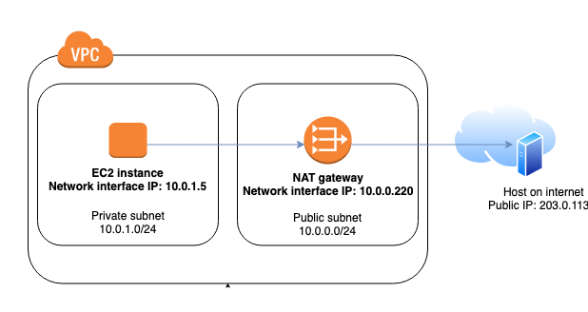
The following custom flow log for the NAT gateway network interface captures the following fields in the following order.
instance-id interface-id srcaddr dstaddr pkt-srcaddr pkt-dstaddr
The flow log shows the flow of traffic from the instance IP address (10.0.1.5) through the NAT gateway network interface to a host on the internet (203.0.113.5). The NAT gateway network interface is a requester-managed network interface, therefore the flow log record displays a '-' symbol for the instance-id field.
The following line shows traffic from the source instance to the NAT gateway network interface. The values for the dstaddr and pkt-dstaddr fields are different. The dstaddr field displays the private IP address of the NAT gateway network interface, and the pkt-dstaddr field displays the final destination IP address of the host on the internet.
eni-1235b8ca123456789 10.0.1.5 10.0.0.220 10.0.1.5 203.0.113.5
The next two lines show the traffic from the NAT gateway network interface to the target host on the internet, and the response traffic from the host to the NAT gateway network interface.
- eni-1235b8ca123456789 10.0.0.220 203.0.113.5 10.0.0.220 203.0.113.5
eni-1235b8ca123456789 203.0.113.5 10.0.0.220 203.0.113.5 10.0.0.220
The following line shows the response traffic from the NAT gateway network interface to the source instance. The values for the srcaddr and pkt-srcaddr fields are different. The srcaddr field displays the private IP address of the NAT gateway network interface, and the pkt-srcaddr field displays the IP address of the host on the internet.
eni-1235b8ca123456789 10.0.0.220 10.0.1.5 203.0.113.5 10.0.1.5
You create another custom flow log using the same set of fields as above. You create the flow log for the network interface for the instance in the private subnet. In this case, the instance-id field returns the ID of the instance that's associated with the network interface, and there is no difference between the dstaddr and pkt-dstaddr fields and the srcaddr and pkt-srcaddr fields. Unlike the network interface for the NAT gateway, this network interface is not an intermediate network interface for traffic.
i-01234567890123456 eni-1111aaaa2222bbbb3 10.0.1.5 203.0.113.5 10.0.1.5 203.0.113.5 #Traffic from the source instance to host on the internet
i-01234567890123456 eni-1111aaaa2222bbbb3 203.0.113.5 10.0.1.5 203.0.113.5 10.0.1.5 #Response traffic from host on the internet to the source instance
A
1
2
B
4
3
1
2
3
4
A
A
B
B

Slide 13
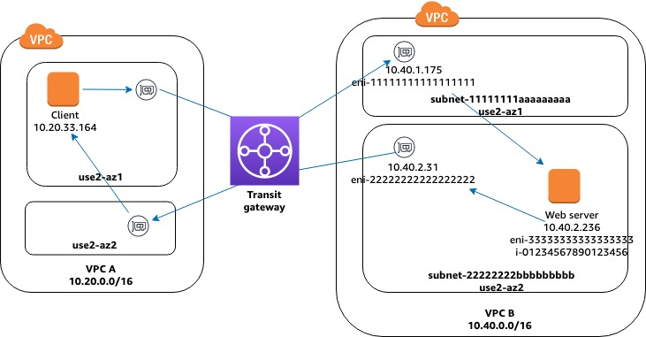
Traffic through a transit gateway
In this example, a client in VPC A connects to a web server in VPC B through a transit gateway. The client and server are in different Availability Zones. Therefore, traffic arrives at the server in VPC B using eni-11111111111111111 and leaves VPC B using eni-22222222222222222.
A
3 eni-11111111111111111 123456789010 vpc-abcdefab012345678 subnet-11111111aaaaaaaaa - 10.40.1.175 10.40.2.236 39812 80 6 3 IPv4 10.20.33.164 10.40.2.236 ACCEPT OK
A
1
2
B
B
3 123456789010 vpc-abcdefab012345678 subnet-22222222bbbbbbbbb - 10.4eni-22222222222222222 10.40.2.236 10.40.2.31 80 39812 6 19 IPv4 10.40.2.236 10.20.33.164 ACCEPT OK
1
3 eni-33333333333333333 123456789010 vpc-abcdefab012345678 subnet-22222222bbbbbbbbb i-01234567890123456 10.20.33.164 10.40.2.236 39812 80 6 3 IPv4 10.20.33.164 10.40.2.236 ACCEPT OK
...
3 eni-33333333333333333 123456789010 vpc-abcdefab012345678 subnet-22222222bbbbbbbbb i-01234567890123456 10.40.2.236 10.20.33.164 80 39812 6 19 IPv4 10.40.2.236 10.20.33.164 ACCEPT OK
2
You create a custom flow log for VPC B with the following format.
version interface-id account-id vpc-id subnet-id instance-id srcaddr dstaddr srcport dstport protocol tcp-flags type pkt-srcaddr pkt-dstaddr action log-status

Slide 14
Service name, traffic path, and flow direction
The following is an example of the fields for a custom flow log record.
In the following example, the version is 5 because the records include version 5 fields. An EC2 instance calls the Amazon S3 service. Flow logs are captured on the network interface for the instance. The first record has a flow direction of ingress and the second record has a flow direction of egress. For the egress record, traffic-path is 8, indicating that the traffic goes through an internet gateway. The traffic-path field is not supported for ingress traffic. When pkt-srcaddr or pkt-dstaddr is a public IP address, the service name is shown
version srcaddr dstaddr srcport dstport protocol start end type packets bytes account-id vpc-id subnet-id instance-id interface-id region az-id sublocation-type sublocation-id action tcp-flags pkt-srcaddr pkt-dstaddr pkt-src-aws-service pkt-dst-aws-service traffic-path flow-direction log-status
5 52.95.128.179 10.0.0.71 80 34210 6 1616729292 1616729349 IPv4 14 15044 123456789012 vpc-abcdefab012345678 subnet-aaaaaaaa012345678 i-0c50d5961bcb2d47b eni-1235b8ca123456789 ap-southeast-2 apse2-az3 - - ACCEPT 19 52.95.128.179 10.0.0.71 S3 - - ingress OK
5 10.0.0.71 52.95.128.179 34210 80 6 1616729292 1616729349 IPv4 7 471 123456789012 vpc-abcdefab012345678 subnet-aaaaaaaa012345678 i-0c50d5961bcb2d47b eni-1235b8ca123456789 ap-southeast-2 apse2-az3 - - ACCEPT 3 10.0.0.71 52.95.128.179 - S3 8 egress OK

Slide 15
Amazon Resource Names (ARNs)
Amazon Resource Names (ARNs) uniquely identify AWS resources. We require an ARN when you need to specify a resource unambiguously
across all of AWS, such as in IAM policies, Amazon Relational Database Service (Amazon RDS) tags, and API calls.
The Service Authorization Reference lists the ARNs that you can use in IAM policies.
ARN format
The following are the general formats for ARNs. The specific formats depend on the resource. To use an ARN, replace the italicized text with the resource-specific information.
Be aware that the ARNs for some resources omit the Region, the account ID, or both the Region and the account ID.
arn:partition:service:region:account-id:resource-id
arn:partition:service:region:account-id:resource-type/resource-id
arn:partition:service:region:account-id:resource-type:resource-id
partition
The partition in which the resource is located. A partition is a group of AWS Regions. Each AWS account is scoped to one partition.
The following are the supported partitions:
aws - AWS Regions
aws-cn - China Regions
aws-us-gov - AWS GovCloud (US) Regions
service
The service namespace that identifies the AWS product. For example, s3 for Amazon S3. To find a service namespace, open the Service Authorization Reference, open the page for the service,
and find the phrase "service prefix" in the first sentence. For example, the following text appears in the first sentence on the page for Amazon S3:
(service prefix: s3)
region
The Region code. For example, us-east-2 for US East (Ohio). For the list of Region codes, see Regional endpoints.
account-id
The ID of the AWS account that owns the resource, without the hyphens. For example, 123456789012.
resource-id
The resource identifier. This part of the ARN can be the name or ID of the resource or a resource path. For example, user/Bob for an IAM user or instance/i-1234567890abcdef0 for an EC2 instance.
Some resource identifiers include a parent resource (sub-resource-type/parent-resource/sub-resource) or a qualifier such as a version (resource-type:resource-name:qualifier).
Paths in ARNs
Resource ARNs can include a path. For example, in Amazon S3, the resource identifier is an object name that can include slashes (/) to form a path. Similarly, IAM user names and group names can include paths.
Paths can include a wildcard character, namely an asterisk (*). For example, if you are writing an IAM policy, you can specify all IAM users that have the path product_1234 using a wildcard as follows:
arn:aws:iam::123456789012:user/Development/product_1234/*
Similarly, you can specify user/* to mean all users or group/* to mean all groups, as in the following examples:
"Resource":"arn:aws:iam::123456789012:user/*"
"Resource":"arn:aws:iam::123456789012:group/*"
The following example shows ARNs for an Amazon S3 bucket in which the resource name includes a path:
arn:aws:s3:::my_corporate_bucket/*
arn:aws:s3:::my_corporate_bucket/Development/*
Incorrect wildcard usage
You cannot use a wildcard in the portion of the ARN that specifies the resource type, such as the term user in an IAM ARN. For example, the following is not allowed.
arn:aws:iam::123456789012:u* <== not allowed

Slide 16
VPC Flows AWS
(2) CloudWatch
Events
(1) VPC Logs
(3) Converts
Events
EC2
Instances
CloudWatch
Lambda
(4) Discovery
of VPC
GigaFlow
VPC configured to send logs to CloudWatch
CloudWatch triggers when it receives logs and forwards as events to a Lambda
This Lambda written in NodeJS converts events to flows and forwards to GigaFlow
Gigaflow runs a discovery to map EC2 instance information

Slide 17
VPC Flows AWS
(1) VPC Logs
EC2
Instances
(2) Read and Delete VPCflow log files
GigaFlow
VPC configured to send logs to S3
Custom defined VPCflow fields version 2-5
Gigaflow reads and deletes VPCflow log files from S3 bucket

Slide 18
// var data = {'messageType': 'DATA_MESSAGE', 'owner': '089333653190', 'logGroup': 'VPCToFlowSec', 'logStream': 'eni-89539fd8-all', 'subscriptionFilters': ['VPCToFlowSecFilter'],
// 'logEvents': [
// {'id': '33964523925802107227373744113083769472984007266894413827', 'timestamp': 1523021927000, 'message': '2 089333653190 eni-89539fd8 172.31.9.104 66.228.42.59 53058 123 17 1 76 1523021927 1523021965 ACCEPT OK'},
// {'id': '33964523925802107227373744113083769472984007266894413828', 'timestamp': 1523021927000, 'message': '2 089333653190 eni-89539fd8 66.228.42.59 172.31.9.104 123 53058 17 1 76 1523021927 1523021965 ACCEPT OK'},
// {'id': '33964523925802107227373744113083769472984007266894413829', 'timestamp': 1523021927000, 'message': '2 089333653190 eni-89539fd8 172.31.9.104 154.16.245.246 40120 123 17 1 76 1523021927 1523021965 ACCEPT OK'},
// {'id': '33964523925802107227373744113083769472984007266894413830', 'timestamp': 1523021927000, 'message': '2 089333653190 eni-89539fd8 154.16.245.246 172.31.9.104 123 40120 17 1 76 1523021927 1523021965 ACCEPT OK'},
// {'id': '33964524862433405565659916057583936924215190518071885831', 'timestamp': 1523021969000, 'message': '2 089333653190 eni-89539fd8 60.210.141.213 172.31.9.104 55577 23 6 1 40 1523021969 1523022025 REJECT OK'},
// {'id': '33964524862433405565659916057583936924215190518071885834', 'timestamp': 1523021969000, 'message': '2 089333653190 eni-89539fd8 77.72.82.92 172.31.9.104 51550 21879 6 1 40 1523021969 1523022025 REJECT OK'}]};
'use strict';
const zlib = require('zlib');
const PORT = 2055;
const HOST = '83.70.199.180';
var dgram = require('dgram');
//type, length,stringposition,parsertype
//parsertypes 0=parseint,1=ip,2=string,3=observationTimeSeconds,4=flowDurationMilliseconds
const templatefields = [
[8, 4, 3, 1], //srcip
[12, 4, 4, 1], //dstip
[7, 2, 5, 0], //srcport
[11, 2, 6, 0], //dstport
[4, 1, 7, 0], //proto
[1, 4, 9, 0], //bytes
[2, 4, 8, 0], //pkts
[322, 4, 10, 3], //observationTimeSeconds
[161, 4, 11, 4], //flowDurationMilliseconds
// [32768 + 1, 4, 53020], //SourceIPV4
// [32768 + 2, 65535, 53020], //SourceName
[32768 + 80, 65535, 2, 2, 53020], //in interface name
[32768 + 81, 65535, 2, 2, 53020], //out interface name
[32768 + 101, 65535, 12, 2, 53020] //fw event
];
const templateSetBuffer = new Buffer.alloc(1472);
const templateSet = generateTemplateSetV9(templateSetBuffer);
//var parsed = testdata;
function process(parsed) {
// seq = 0;
var timenow = new Date().getTime();
var nowsec = ToInt32(timenow / 1000);
var exportBuffer = new Buffer.alloc(1472);
var flowRecordBuffer = new Buffer.alloc(1500);
addExportHeaderV9(timenow, exportBuffer, 0);
var cli = dgram.createSocket('udp4');
cli.bind(45672);
addV9Flows(0, 16, exportBuffer, 0, nowsec, timenow, 0, flowRecordBuffer,cli,parsed);
}
exports.handler = function (event, context) {
var payload = new Buffer.from(event.awslogs.data, 'base64');
//console.log("Running" + new Date().getTime());
zlib.gunzip(payload, function (e, result) {
if (e) {
context.fail(e);
} else {
var parsed = JSON.parse(result.toString('utf8'));
//console.log("parsed" + new Date().getTime());
console.log("Have " + parsed.logEvents.length + " flows");
process(parsed);
}
});
};
function generateTemplateSetV9(message) {
var offset = 0;
message.writeUInt16BE(2, offset + 0); //vers
message.writeUInt16BE(281, offset + 4); //template id
message.writeUInt16BE(templatefields.length, offset + 6); //fields
offset += 8;
for (var i = 0; i < templatefields.length; i++) {
message.writeUInt16BE(templatefields[i][0], offset); //fields
message.writeUInt16BE(templatefields[i][1], offset + 2); //fields
if (templatefields[i][0] > 32768) {//pen
message.writeUInt32BE(templatefields[i][4], offset + 4);
offset += 8;
} else {
offset += 4;
}
}
message.writeUInt16BE(offset, 2); //length
return message.slice(0, offset);
}
function addV9Flows(pos, offset, exportBuffer, setStart, nowsec, timenow, seq, flowRecordBuffer,client,parsed) {
//console.log("addV9Flows pos:" + pos + " offset:" + offset + " total flows:" + parsed.logEvents.length + " " + (pos < parsed.logEvents.length) + " seq:" + seq + " setStart:" + setStart);
if (pos < parsed.logEvents.length) {
var flowRecordsOffset = getV9Record(parsed.logEvents[pos],flowRecordBuffer);
if (flowRecordsOffset > 0) {
if (offset + flowRecordsOffset > 1470) {
//if (seq === 1) Sending first export
//else Sending intermediete export
exportBuffer.writeUInt16BE(offset, 2); //length of export
client.send(exportBuffer, 0, offset, PORT, HOST, function (err, bytes) {
if (err) {
console.log("Error");
throw err;
}
console.log('UDP message in sent to ' + HOST + ':' + PORT);
addV9Flows(pos++, 16, exportBuffer, setStart, nowsec, timenow, seq, flowRecordBuffer,client,parsed);
});
} else {
if (offset === 16) {//new packet
//console.log("-new packet");
seq++;
exportBuffer.writeUInt32BE(seq, 8); //sequence
if (seq === 1) { //first record, send template
//console.log("-first export");
templateSet.copy(exportBuffer, 16);
offset = 16 + templateSet.length;
setStart = 16 + templateSet.length;
} else {
setStart = offset;
}
exportBuffer.writeUInt16BE(281, setStart); //set type
offset += 4;
}
offset += flowRecordBuffer.copy(exportBuffer, offset,0,flowRecordsOffset);
exportBuffer.writeUInt16BE(offset - setStart, setStart + 2); //set type
pos++;
if (pos === parsed.logEvents.length) {
exportBuffer.writeUInt16BE(offset, 2); //length of export
if (offset > 16) {//flows remaining
//console.log("++++++++++++++++++Sending last export seq:" + seq);
client.send(exportBuffer, 0, offset, PORT, HOST, function (err, bytes) {
if (err) {
console.log("Error");
throw err;
}
client.close();
console.log('UDP message out sent to ' + HOST + ':' + PORT);
});
} else {
client.close();
}
} else {
addV9Flows(pos, offset, exportBuffer, setStart, nowsec, timenow, seq, flowRecordBuffer,client,parsed);
}
}
}else{
addV9Flows(pos+1, offset, exportBuffer, setStart, nowsec, timenow, seq, flowRecordBuffer,client,parsed);
}
}
}
function getV9Record(record, flowRecordBuffer) {
var offset = 0;
var d = record.message.split(" ");
if (d.length === 14) {
for (var i = 0; i < templatefields.length; i++) {
if (templatefields[i][3] === 0) {
if (templatefields[i][1] === 1) {
flowRecordBuffer.writeUInt8(parseInt(d[templatefields[i][2]], 10), offset);
} else if (templatefields[i][1] === 2) {
flowRecordBuffer.writeUInt16BE(parseInt(d[templatefields[i][2]], 10), offset);
} else if (templatefields[i][1] === 4) {
flowRecordBuffer.writeInt32BE(parseInt(d[templatefields[i][2]], 10), offset);
}
offset += templatefields[i][1];
} else if (templatefields[i][3] === 1) {
flowRecordBuffer.writeInt32LE(inet_atoi(d[templatefields[i][2]]), offset);
offset += templatefields[i][1];
} else if (templatefields[i][3] === 2) {
flowRecordBuffer.writeUInt8(d[templatefields[i][2]].length, offset);
flowRecordBuffer.write(d[templatefields[i][2]], offset + 1);
offset += (d[templatefields[i][2]].length + 1);
}else if (templatefields[i][3] === 3) {
flowRecordBuffer.writeInt32BE(parseInt(d[templatefields[i][2]], 10), offset);
offset += templatefields[i][1];
}else if (templatefields[i][3] === 4) {
flowRecordBuffer.writeInt32BE((parseInt(d[templatefields[i][2]], 10)-parseInt(d[(templatefields[i][2])-1], 10))*1000, offset);
offset += templatefields[i][1];
}
}
}
return offset;
}
function addExportHeaderV9(timenow, message, seq) {
message.writeUInt16BE(10, 0); //vers
message.writeUInt16BE(9, 2); //records in this packet
message.writeUInt32BE(ToInt32(timenow / 1000), 4); //sys_uptime milliseconds
message.writeUInt32BE(seq, 8); //sequence
message.writeUInt32BE(1, 12); //domain id
}
function inet_atoi(addr) {
var parts = addr.split('.').map(function (str) {
return parseInt(str, 10);
});
return (parts[3] ? parts[3] << 24 : 0) +
(parts[2] ? parts[2] << 16 : 0) +
(parts[1] ? parts[1] << 8 : 0) +
parts[0];
}
function ToInt32(x) {
return x << 0;
}
//Copyright Anuview.net 2019

Slide 19
AWS Flow logs
https://docs.aws.amazon.com/vpc/ latest/userguide/flow-logs-records-examples.html
https://docs.aws.amazon.com/vpc/latest/userguide/flow-logs.html
Aggregation interval
The aggregation interval is the period of time during which a particular flow is captured and aggregated into a flow log record. By default, the maximum aggregation interval is 10 minutes. When you create a flow log, you can optionally specify a maximum aggregation interval of 1 minute. Flow logs with a maximum aggregation interval of 1 minute produce a higher volume of flow log records than flow logs with a maximum aggregation interval of 10 minutes.
When a network interface is attached to a Nitro-based instance, the aggregation interval is always 1 minute or less, regardless of the specified maximum aggregation interval.
After data is captured within an aggregation interval, it takes additional time to process and publish the data to CloudWatch Logs or Amazon S3. The flow log service typically delivers logs to CloudWatch Logs in about 5 minutes and to Amazon S3 in about 10 minutes. However, log delivery is on a best effort basis, and your logs might be delayed beyond the typical delivery time.

Slide 20
https://docs.servicenow.com/bundle/sandiego-it-operations-management/page/product/service-mapping/task/configure-netflow-service-mapping.html
https://docs.servicenow.com/bundle/quebec-it-operations-management/page/product/service-mapping/concept/data-collection-vpc-mapping.html
https://docs.servicenow.com/bundle/sandiego-it-operations-management/page/product/service-mapping/task/test-netflow-service-mapping.html
https://docs.servicenow.com/bundle/sandiego-it-operations-management/page/product/service-mapping/concept/data-collection-netflow-mapping.html
https://docs.servicenow.com/bundle/sandiego-servicenow-platform/page/product/business-service-management-map-ng/task/t_CreateMapScript.html
https://docs.servicenow.com/bundle/quebec-it-operations-management/page/product/discovery/reference/r_ApplicationDependencyMapping.html#r_ApplicationDependencyMapping

