Slide 1
CTRL + Click
to Login
Bill.proctor@viavisolutions.com
Bill.proctor@viavisolutions.com
IP 73.34.196.99
VPN IP Pool
Internet
10.238.122.202
157.234.213.6
(External IP)
1
User & Remote IP
VPN Concentrator
10.106.5.40
(Server Actual IP)
2
User & Remote IP
Load Balancer
157.234.106.93
(LB Virtual IP)
3
Bill.proctor@viavisolutions.com
Bill.proctor@viavisolutions.com
10.238.122.202
IP 73.34.196.99
Internet
10.238.122.202
10.238.122.202
10.238.122.202
192.168.68.101
Load Balancer
10.106.5.40
(Server Actual IP)
157.234.213.6
(External IP)
157.234.106.93
(LB Virtual IP)

Slide 2
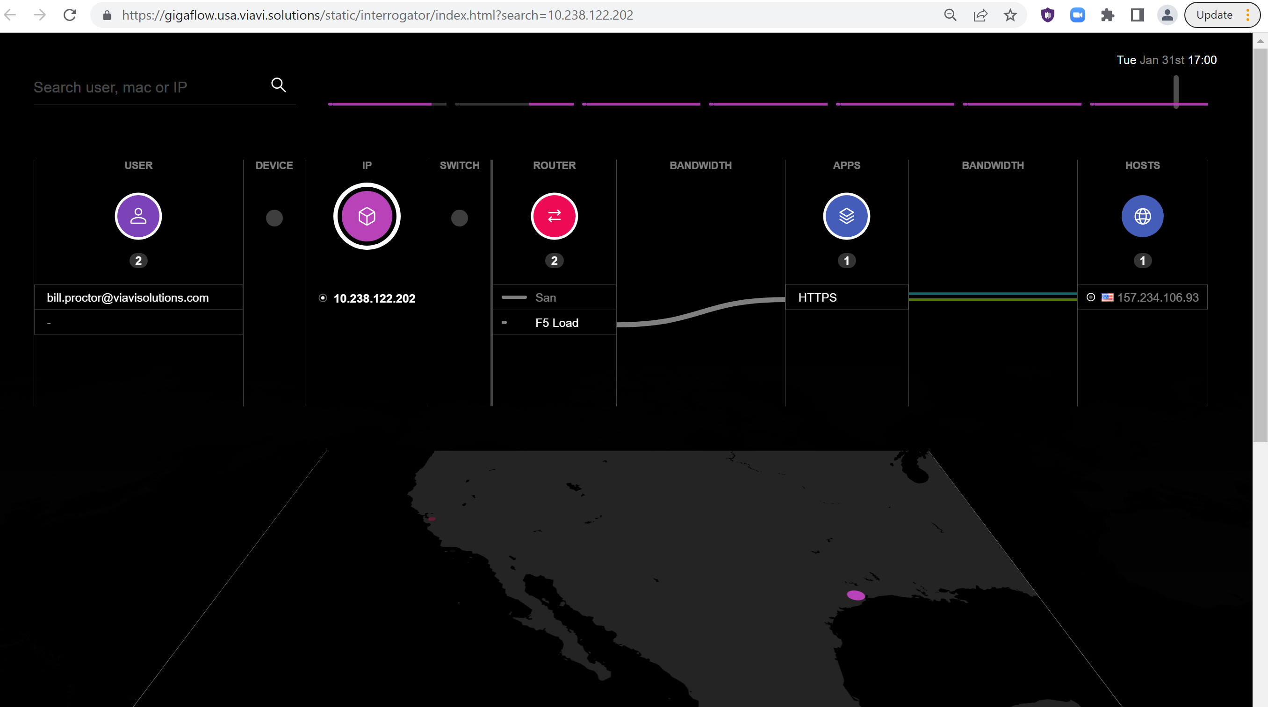

Slide 3
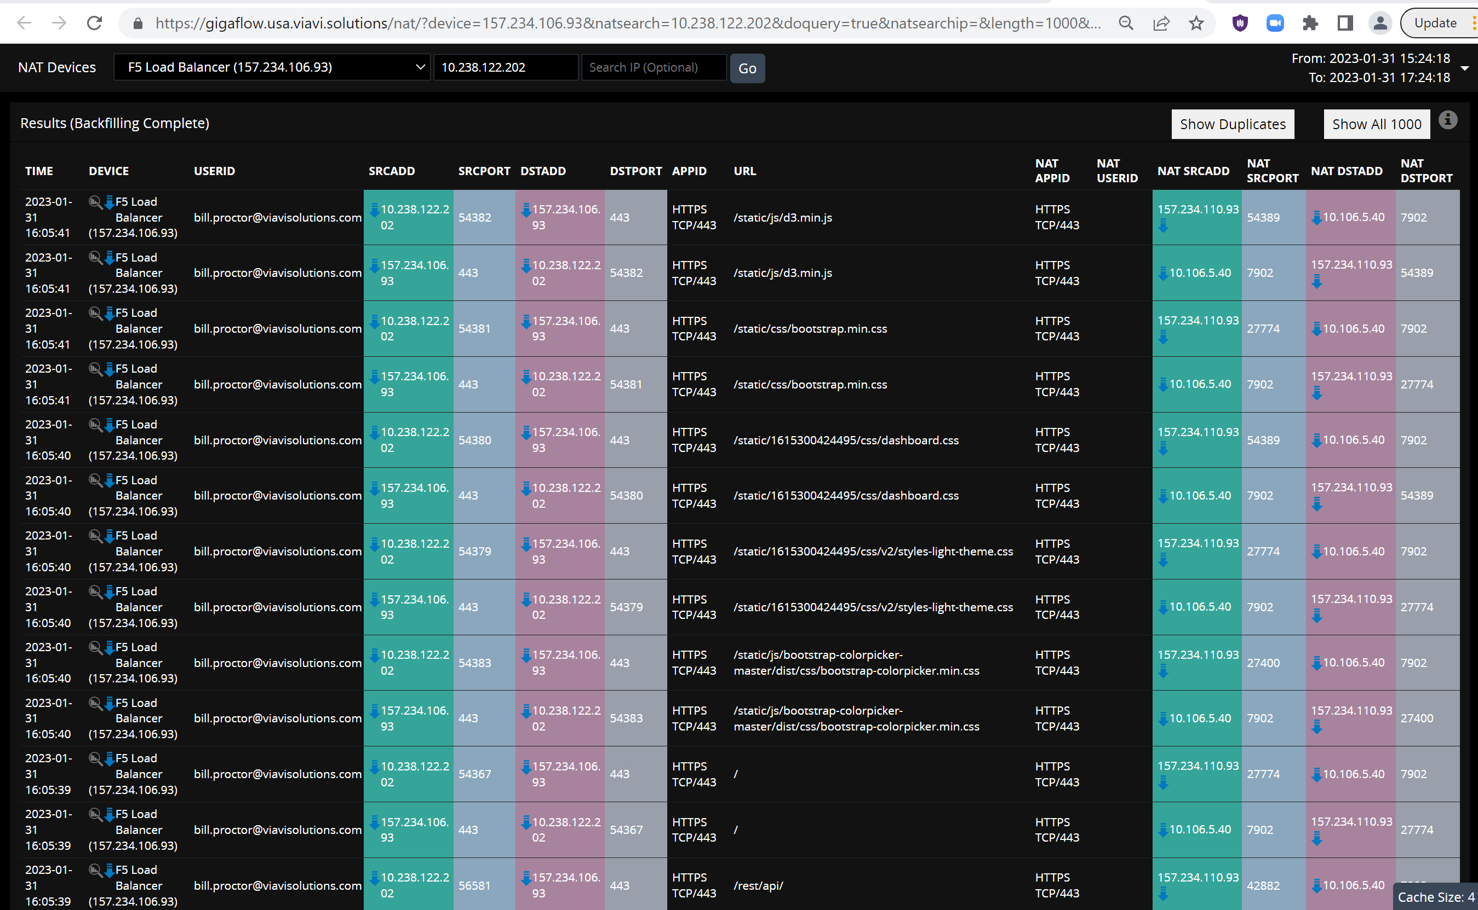

Slide 4
Logging Profile High Speed Logging HSL
https://support.f5.com/kb/en-us/products/big-ip_ltm/manuals/product/bigip-external-monitoring-implementations-12-1-2/2.html Parameter Log file entry description BIGIP_BLADE_ID An entry for the slot number of the blade that handled the request. BIGIP_CACHED An entry of Cached status: true, if the response came from BIG-IP® cache, or Cached status: false, if the response came from the server. BIGIP_HOSTNAME An entry for the configured host name of the unit or chassis. CLIENT_IP An entry for the IP address of a client, for example, 192.168.74.164. CLIENT_PORT An entry for the port of a client, for example, 80. DATE_D A two-character entry for the day of the month, ranging from 1 (note the leading space) through 31. DATE_DAY An entry that spells out the name of the day. DATE_DD A two-digit entry for the day of the month, ranging from 01 through 31. DATE_DY A three-letter entry for the day, for example, Mon. DATE_HTTP A date and time entry in an HTTP format, for example, Tue, 5 Apr 2011 02:15:31 GMT. DATE_MM A two-digit month entry, ranging from 01 through 12. DATE_MON A three-letter abbreviation for a month entry, for example, APR. DATE_MONTH An entry that spells out the name of the month. DATE_NCSA A date and time entry in an NCSA format, for example, dd/mm/yy:hh:mm:ss ZNE. DATE_YY A two-digit year entry, ranging from 00 through 99. DATE_YYYY A four-digit year entry. HTTP_CLASS The name of the httpclass profile that matched the request, or an empty entry if a profile name is not associated with the request. HTTP_KEEPALIVE A flag summarizing the HTTP1.1 keep-alive status for the request:: aY if the HTTP1.1 keep-alive header was sent, or an empty entry if not. HTTP_METHOD An entry that defines the HTTP method, for example, GET, PUT, HEAD, POST, DELETE, TRACE, or CONNECT. HTTP_PATH An entry that defines the HTTP path. HTTP_QUERY The text following the first ? in the URI. HTTP_REQUEST The complete text of the request, for example, $METHOD $URI $VERSION. HTTP_STATCODE The numerical response status code, that is, the status response code excluding subsequent text. HTTP_STATUS The complete status response, that is, the number appended with any subsequent text. HTTP_URI An entry for the URI of the request. HTTP_VERSION An entry that defines the HTTP version. NCSA_COMBINED An NCSA Combined formatted log string, for example, $NCSA_COMMON $Referer ${User-agent} $Cookie. NCSA_COMMON An NCSA Common formatted log string, for example, $CLIENT_IP - - $DATE_NCSA $HTTP_REQUEST $HTTP_STATCODE $RESPONSE_SIZE. RESPONSE_MSECS The elapsed time in milliseconds (ms) between receiving the request and sending the response. RESPONSE_SIZE An entry for the size of response in bytes. RESPONSE_USECS The elapsed time in microseconds (µs) between receiving the request and sending the response. SERVER_IP An entry for the IP address of a server, for example, 10.10.0.1. SERVER_PORT An entry for the port of a logging server. SNAT_IP An entry for the self IP address of the BIG-IP-originated connection to the server when SNAT is enabled, or an entry for the client IP address when SNAT is not enabled. SNAT_PORT An entry for the port of the BIG-IP-originated connection to the server when SNAT is enabled, or an entry for the client port when SNAT is not enabled. TIME_AMPM A twelve-hour request-time qualifier, for example, AM or PM. TIME_H12 A compact twelve-hour time entry for request-time hours, ranging from 1 through 12. TIME_HRS A twelve-hour time entry for hours, for example, 12 AM. TIME_HH12 A twelve hour entry for request-time hours, ranging from 01 through 12. TIME_HMS An entry for a compact request time of H:M:S, for example, 12:10:49. TIME_HH24 A twenty-four hour entry for request-time hours, ranging from 00 through 23. TIME_MM A two-digit entry for minutes, ranging from 00 through 59. TIME_MSECS An entry for the request-time fraction in milliseconds (ms). TIME_OFFSET An entry for the time zone, offset in hours from GMT, for example, -11. TIME_SS A two-digit entry for seconds, ranging from 00 through 59. TIME_UNIX A UNIX time entry for the number of seconds since the UNIX epoch, for example, 00:00:00 UTC, January 1st, 1970. TIME_USECS An entry for the request-time fraction in microseconds (µs). TIME_ZONE An entry for the current Olson database or tz database three-character time zone, for example, PDT. VIRTUAL_IP An entry for the IP address of a virtual server, for example, 192.168.10.1. VIRTUAL_NAME An entry for the name of a virtual server. VIRTUAL_POOL_NAME An entry for the name of the pool containing the responding server. VIRTUAL_PORT An entry for the port of a virtual server, for example, 80. VIRTUAL_SNATPOOL_NAME The name of the Secure Network Address Translation pool associated with the virtual server. WAM_APPLICATION_NAM An entry that defines the name of the BIG-IP® acceleration application that processed the request. WAM_X_WA_INFO An entry that specifies a diagnostic string (X-WA-Info header) used by BIG-IP acceleration to process the request. NULL Undelineated strings return the value of the respective header.
https://clouddocs.f5.com/api/irules/HSL.html

Slide 5
Pool for logging

Slide 6
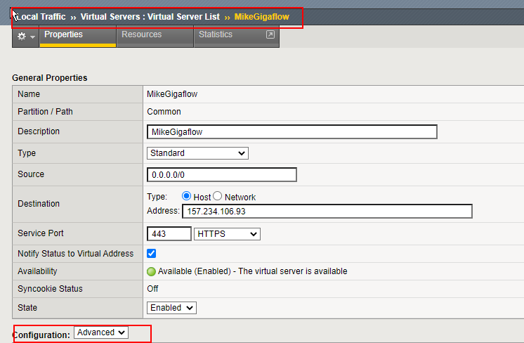
Virtual server settings

Slide 7
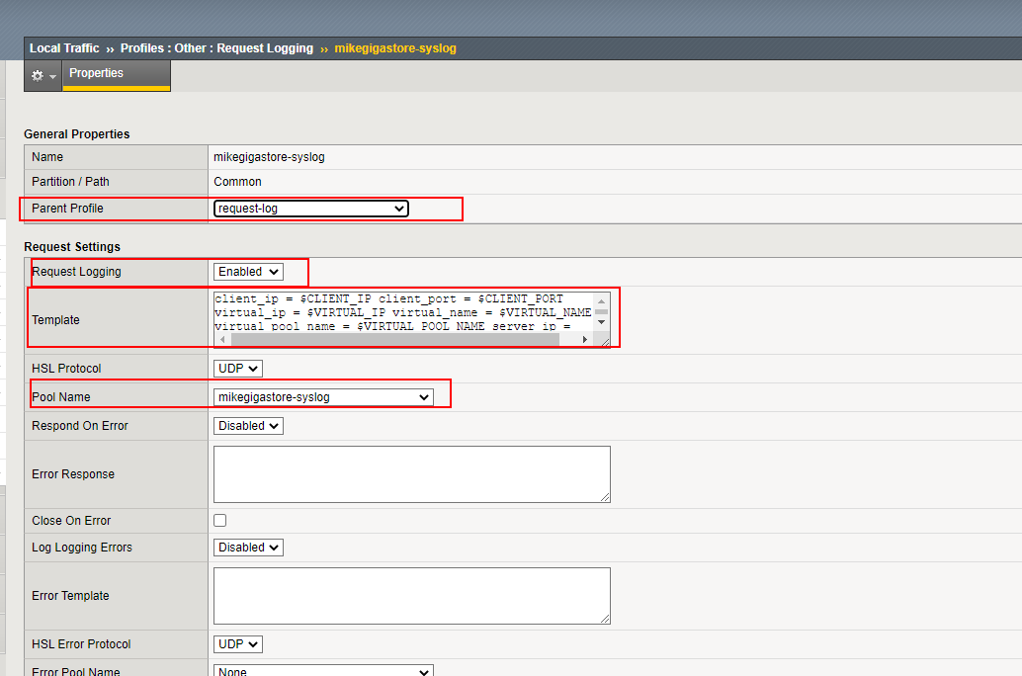
Request logging profile

Slide 8
client_ip = $CLIENT_IP client_port = $CLIENT_PORT
virtual_ip = $VIRTUAL_IP virtual_name = $VIRTUAL_NAME
virtual_pool_name = $VIRTUAL_POOL_NAME server_ip =
$SERVER_IP server_port = $SERVER_PORT snat_port =
$SNAT_PORT snat_ip = $SNAT_IP http_path =
$HTTP_PATH http_request = $HTTP_REQUEST
response_msecs = $RESPONSE_MSECS response_size =
$RESPONSE_SIZE virtual_port = $VIRTUAL_PORT
Example syslog message received in Gigaflow
157.234.106.93:client_ip = 10.238.122.202 client_port = 56566virtual_ip = 157.234.106.93 virtual_name = /Common/MikeGigaflow
virtual_pool_name = /Common/MikeGigaflow-pool server_ip =
10.106.5.40 server_port = 7902 snat_port =
19347 snat_ip = 157.234.110.93 http_path =
"/static/fonts/opensans-regular.woff" http_request = "GET /static/fonts/opensans-regular.woff HTTP/1.1"
response_msecs = 0 response_size =
0 virtual_port = 443
Parser for above message
client_ip = (.+?) client_port = (.+?) \nvirtual_ip = (.+?) virtual_name = \/Common\/(.+?)Gigaflow\s+\nvirtual_pool_name.*server_ip = \n(.+?) server_port = (.+?) snat_port = \n(.+?) snat_ip = (.+?) http_path = \n"(.+?)" http_request = "(.+?) .*\nresponse_msecs = (.+?) response_size = \n(.+?) virtual_port = (.+)

Slide 9
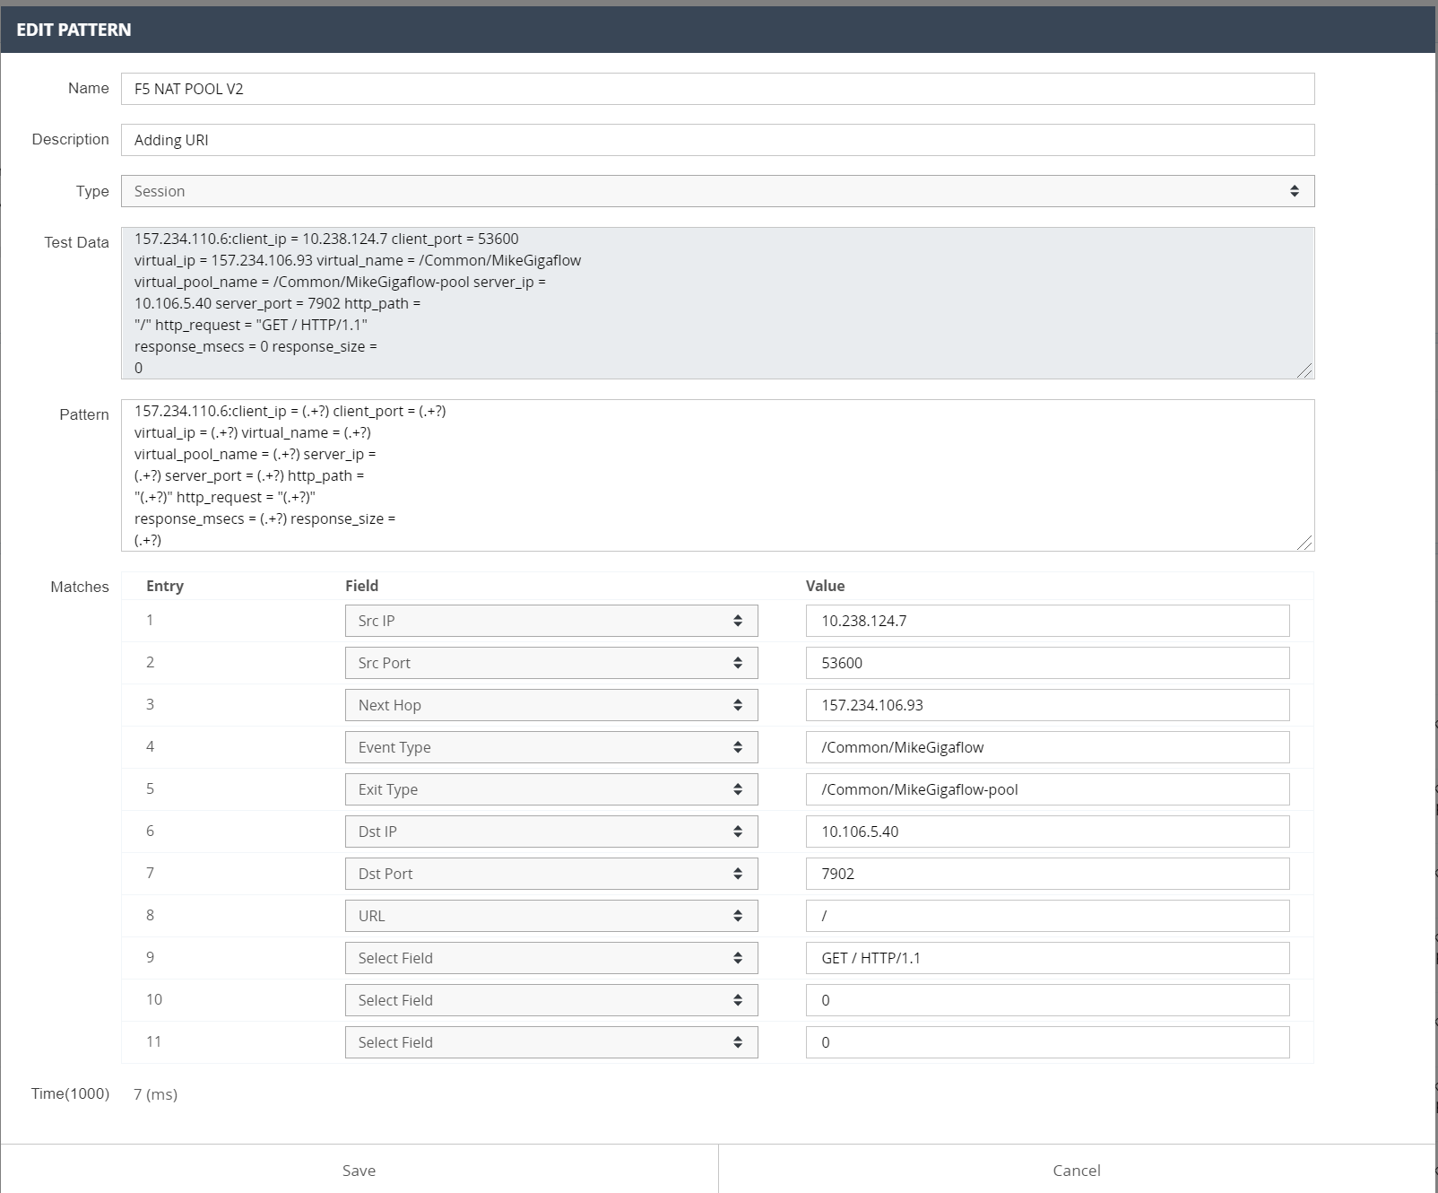

Slide 10
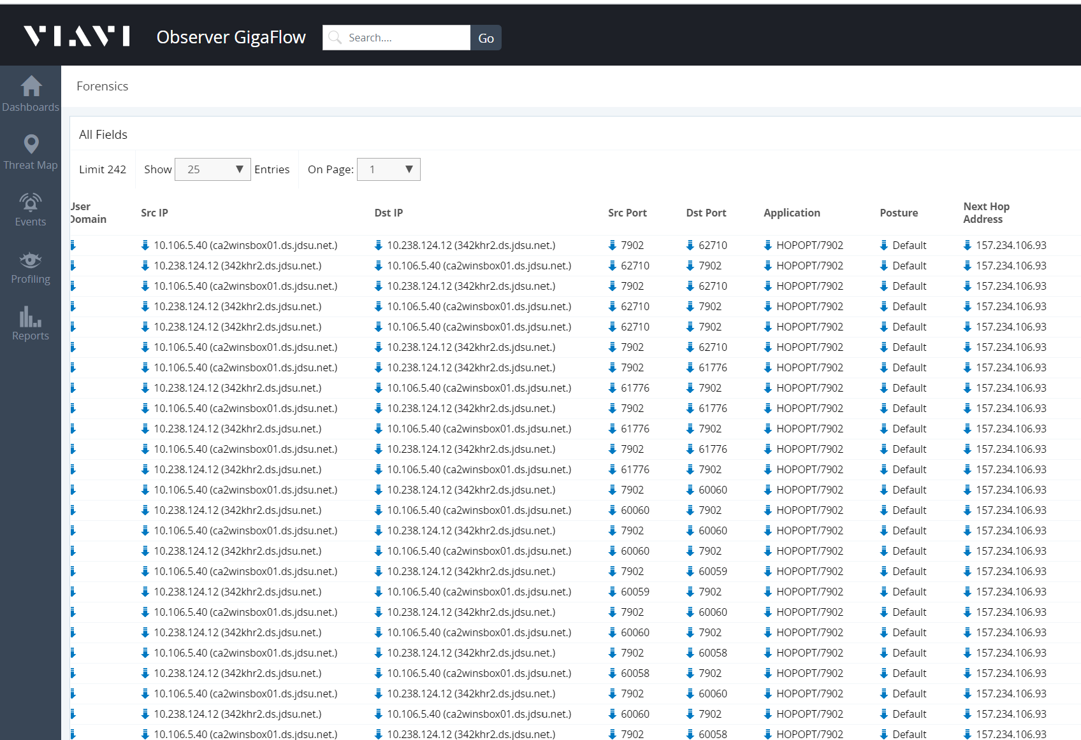
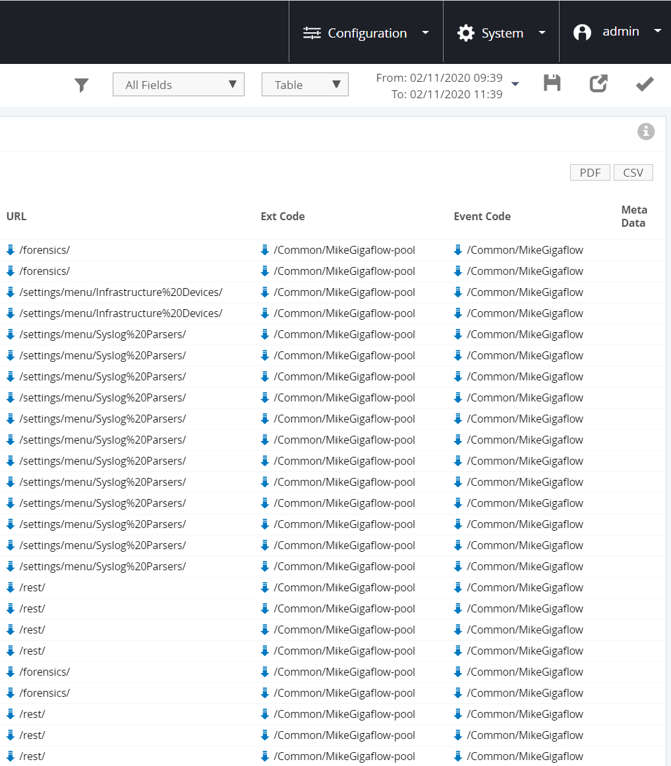

Slide 11
Suggested parser:
client_ip=(.+?),client_port=(.+?),virtual_ip=(.+?),virtual_port=(.+?),virtual_name=(.*?),virtual_pool_name=(.*?),snat_ip=(.*?),snat_port=(.*?),server_ip=(.*?),server_port=(.*?),response_msecs=(.*?),response_size=(.*?),http_request="(.+?)",http_path="(.+?)"

