Slide 1
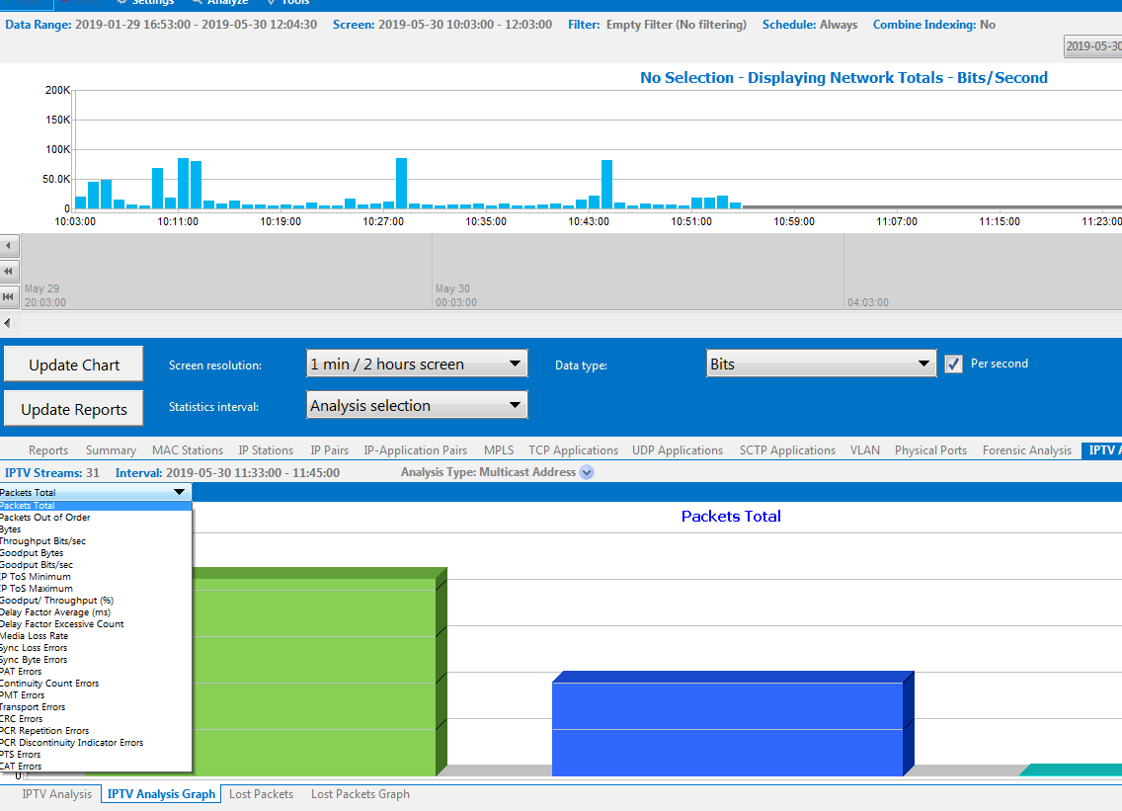
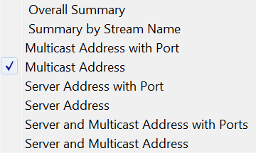
GigaStor Control Panel IPTV stream display. Realtime and back in time by selecting time range in top graph and update reports view below.

Slide 2
GigaStor Control Panel and IPTV Analysis statistics displaying 2 streams

Slide 3
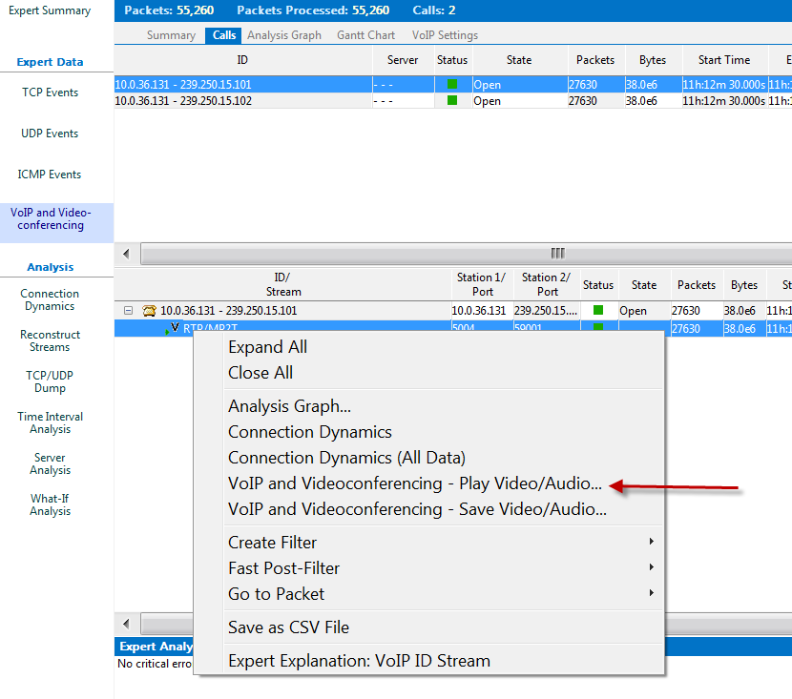
In GigaStor Control Panel you have the ability to playback the IPTV stream if it’s RTP

Slide 4
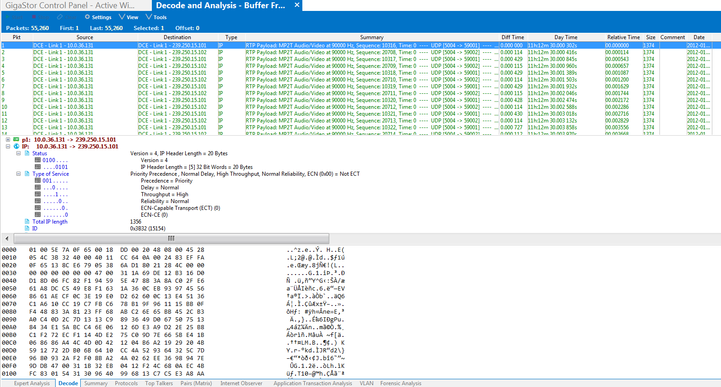
In GigaStor Control Panel you have full packet decodes

Slide 5
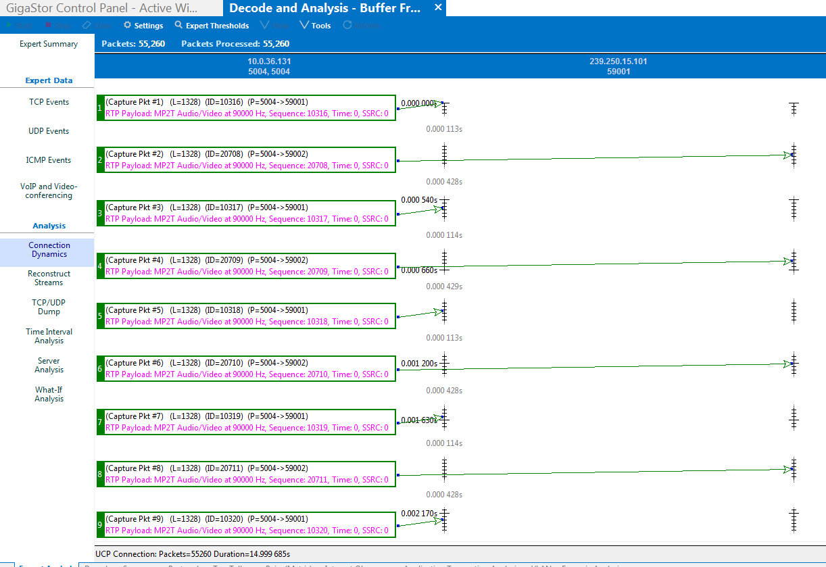
GigaStor Control Panel has Connection Dynamics which is the packet “ladder view” with corresponding times. Easier view than looking at decodes.

Slide 6
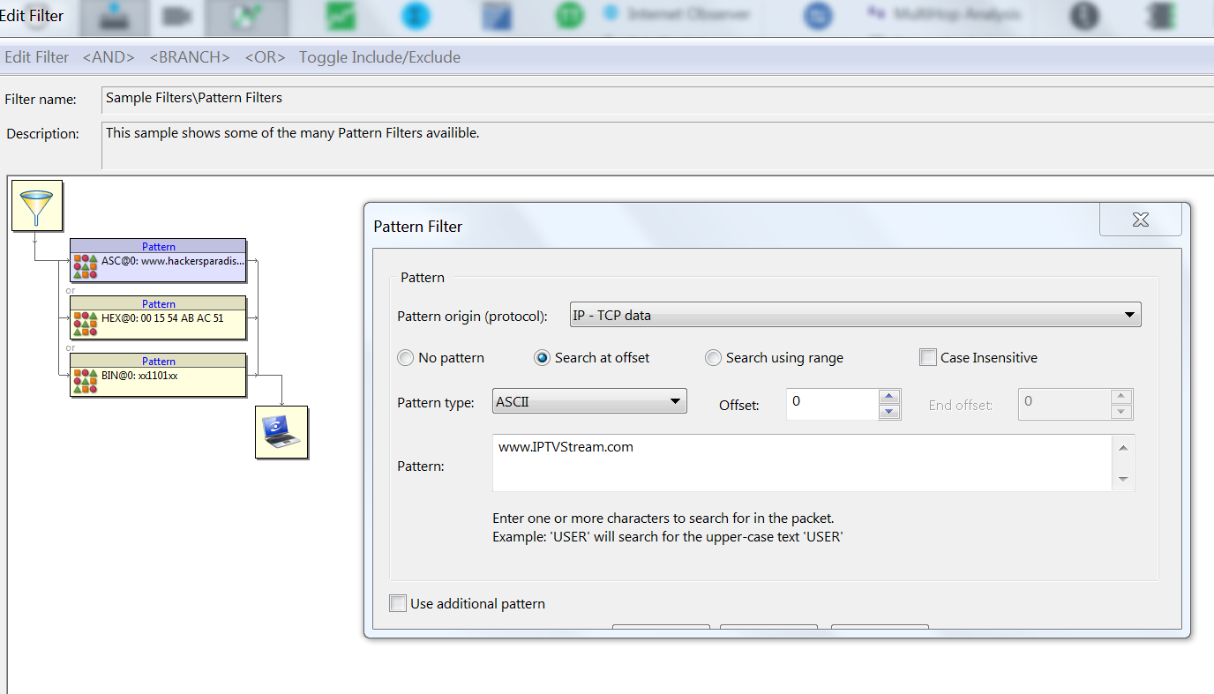
In GigaStor Control Panel you can search for the IPTV Stream using the pattern search

Slide 7
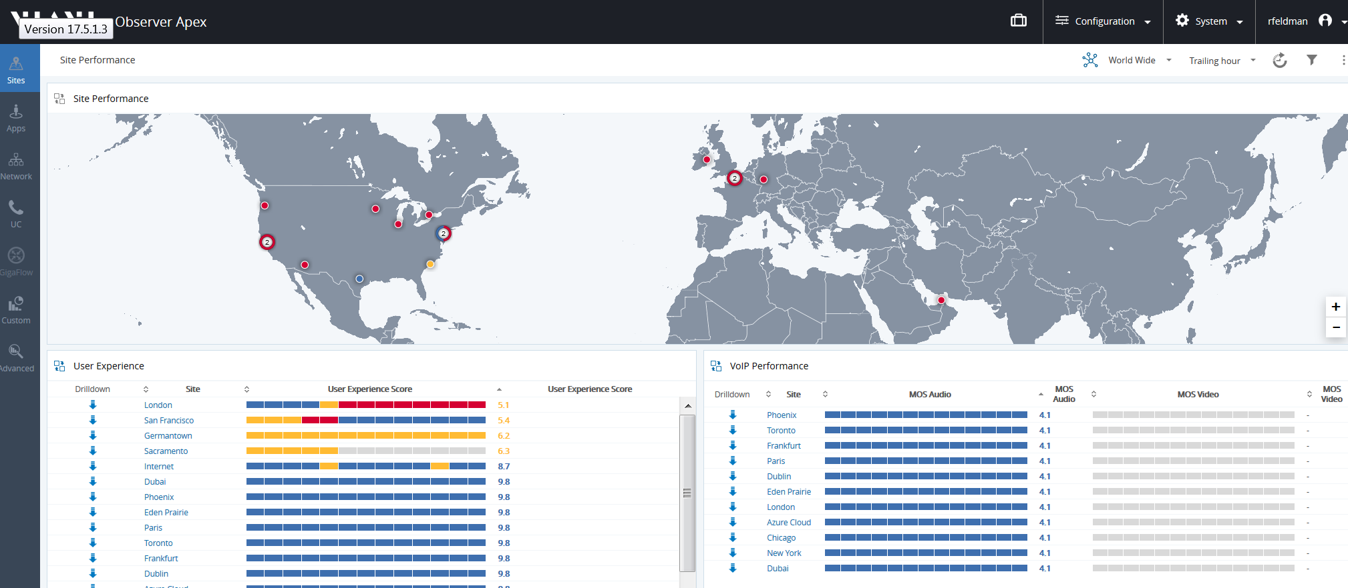
Apex (Web Reporting) – if IPTV stream is RTP, we will show the video MOS and then

Slide 8
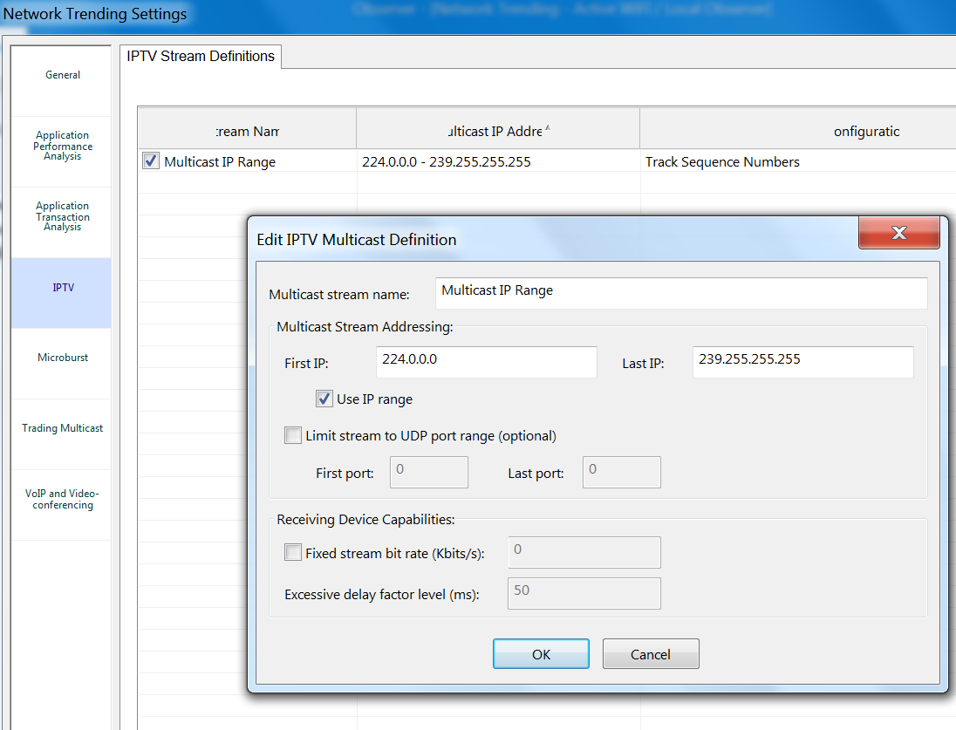
May have to configure IPTV in Network Trending in GigaStor

Slide 9
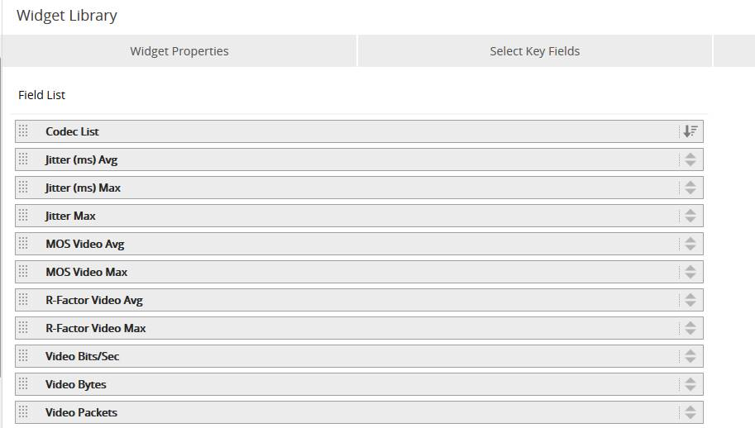
Create a widget with the following fields and add to a Dashboard.

Slide 10
Apex – Video MOS, metrics

