Slide 1
GigaStor Enabling DPI Application and Certificate Analysis Step-by-Step Guide

Slide 2
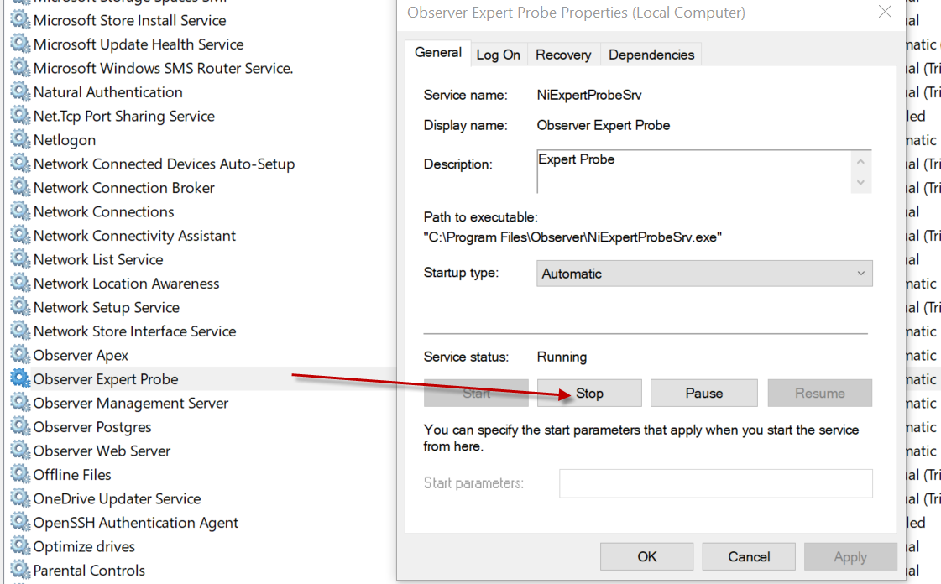
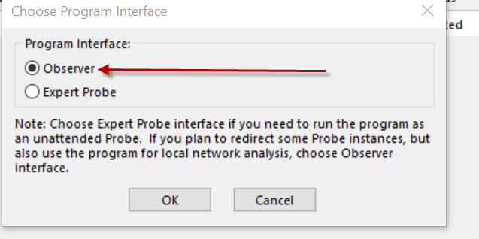
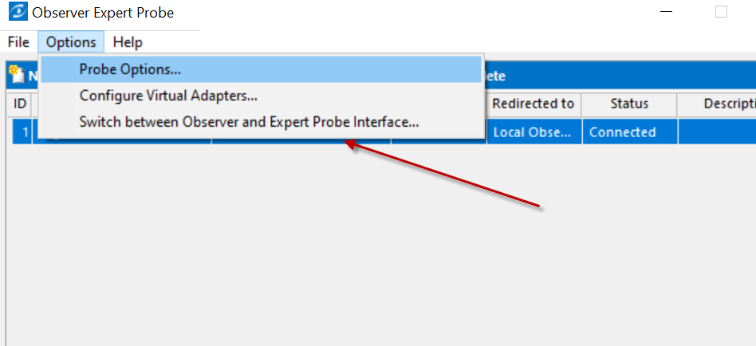
Open Windows Services and Stop the Observer Expert Probe.
Wait 5 seconds and open the Observer application
Click Switch between Observer…, Then Select Observer

Slide 3
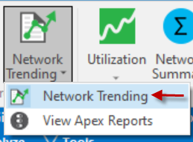
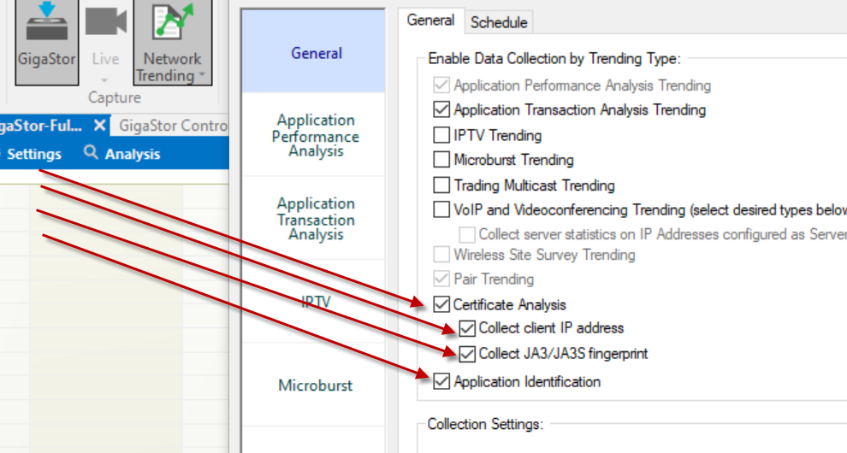
Open Network Trending and enable the below options

Slide 4
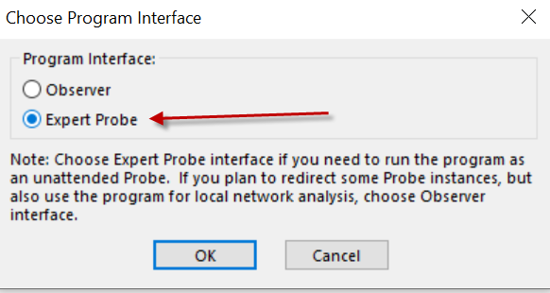
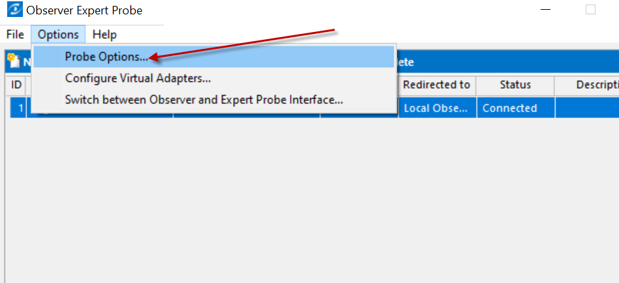
To put GigaStor back into Service Mode
Click File | Options
Click Switch Interface
Click Expert Probe and then OK
Observer application will close. Wait 5 seconds and re-open Observer application.
Click Probe Options and

Slide 5
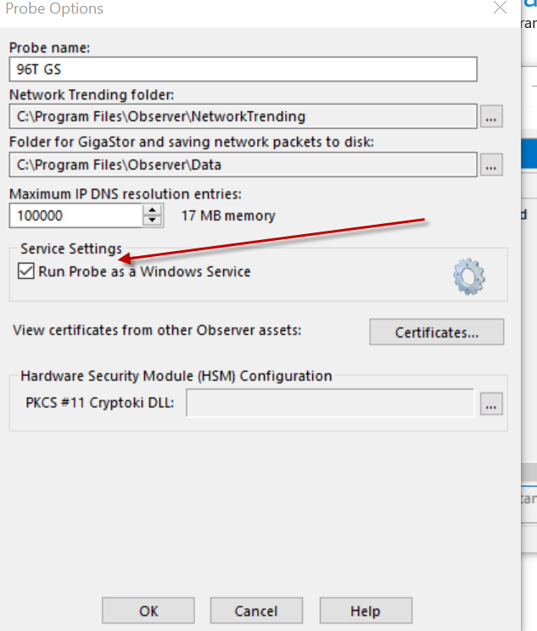
Click Run Probe as a Windows Service

Slide 6
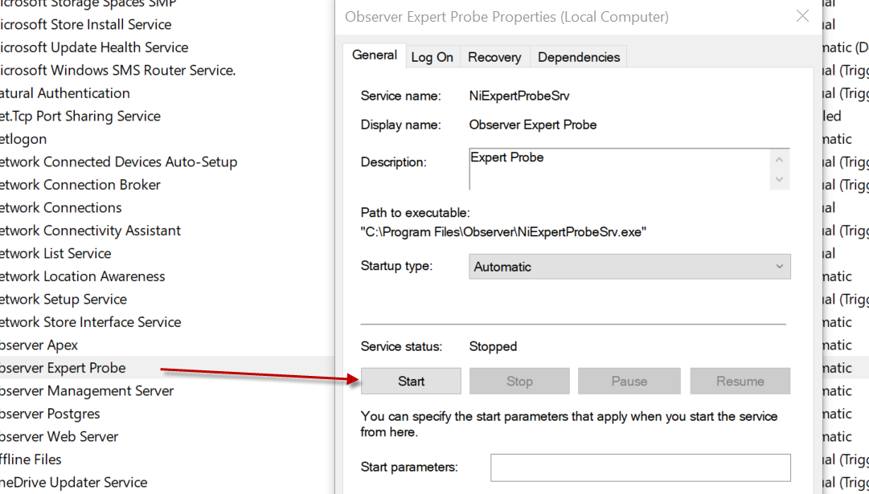
Open Windows Services and Start the Observer Expert service

